Slide 1

Amyloidoses Maria M. Picken MD, PhD mpicken@lumc.edu

Slide 2
Amyloidoses
Abnormal protein folding diseases
Robbins pages 182-187

Slide 3
Goal:
- to increase awareness of amyloidoses as deadly but
frequently treatable disease
- to emphasize the critical importance of early diagnosis
Objectives:
explain why amyloid forms
describe when to suspect amyloidosis
describe how to diagnose amyloidosis
describe what are the treatment options

Slide 4
Outline:
Amyloid: what is it and why it forms
Major types of amyloid
Clinical presentation
Pathogenesis and pathology
Diagnosis: generic and protein-type specific
Treatments
Amyloid beyond disease

Slide 5
Amyloid: what is it and why it forms
Name = misnomer: “amyloid” means starch
but deposits of amyloid contain predominantly protein
which became mis-folded
Amyloidoses = amyloid diseases

Slide 6
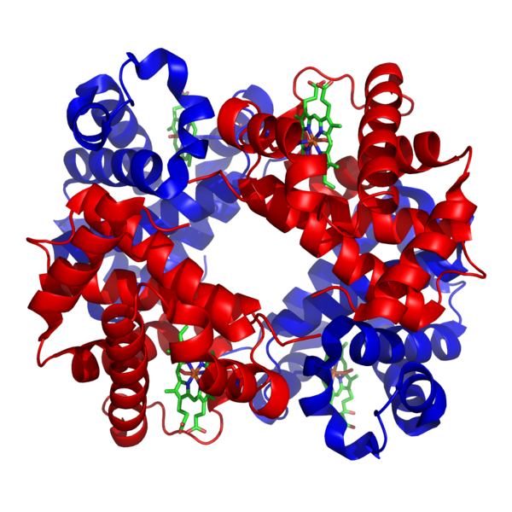
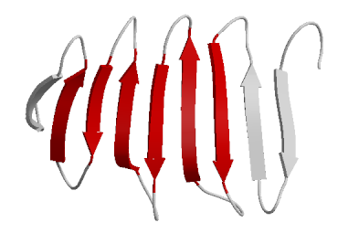
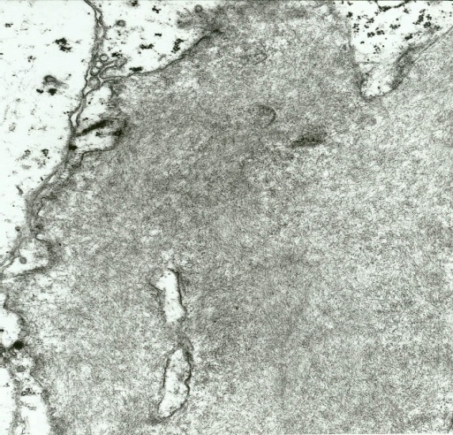
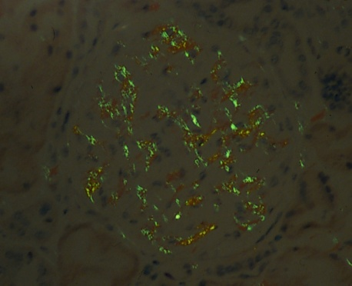
Amyloidoses – protein folding disorders
non-branching fibrils by
electron microscopy
α helix
β pleated sheet
Fibrillogenesis
Conformational shift to
β-pleated sheet 2⁰ structure
hydrophobic, insoluble
non-functional
resistant to degradation
sticky (prone to aggregation)
extracellular
affinity to Congo red stain
fibrillar (by electron microscopy)
Congo red positivity
with green birefringence
under polarized light

Slide 7
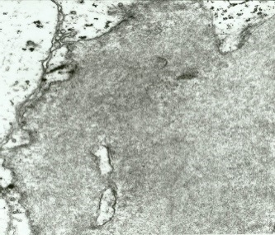


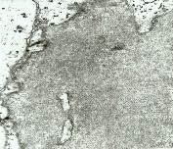
Amyloidoses – protein folding disorders
protein quality control systems:
intracellular (proteasomes)
extracellular (macrophages)
Increased concentration
Intrinsic instability
mutations
Proteolytic cleavage
precursor protein
misfolded protein
protofibril
mature fibrils

Slide 8
AMYLOIDOSES:
>32 protein types, many more variants
Systemic or systemic or/and localized, some only localized
Most prevalent versus rare versus exceedingly rare
Specific organs, i.e. cerebral, endocrine organs…
Treatable versus not-treatable, genetics…
Most common:
AL (Amyloid Light chain)
AA (Amyloid A protein)
Aβ (Amyloid β protein)

Slide 9
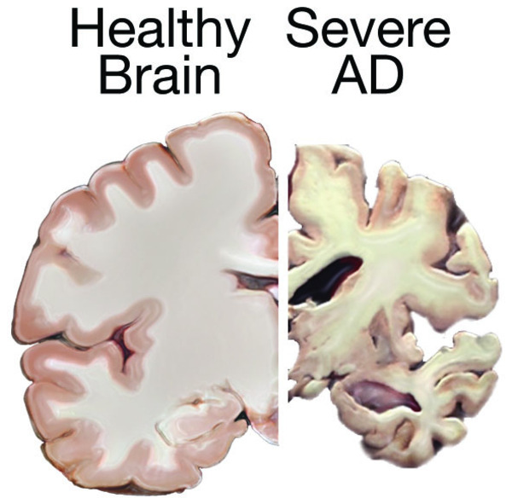
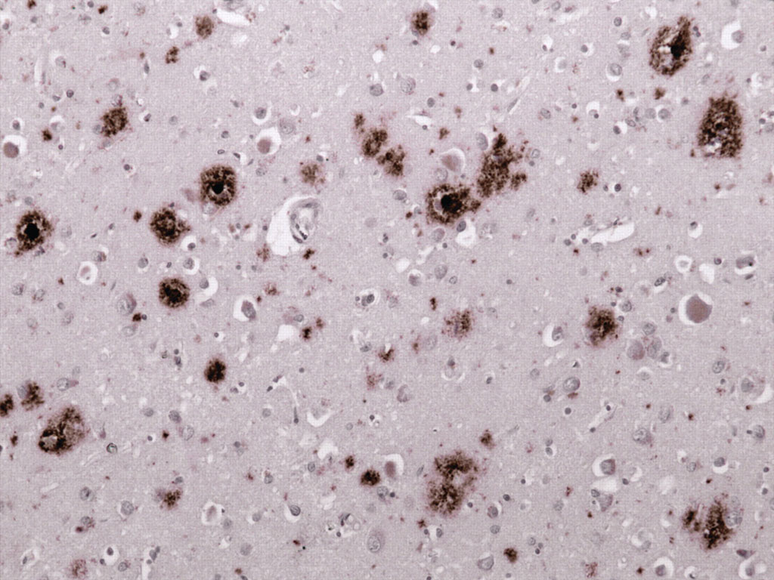
Cerebral Amyloidosis: β-amyloid protein (Aβ)
Alzheimer’s disease (AD)
Localized amyloid deposits limited to brain
Several neurodegenerative disorders begin with amyloid…

Slide 10
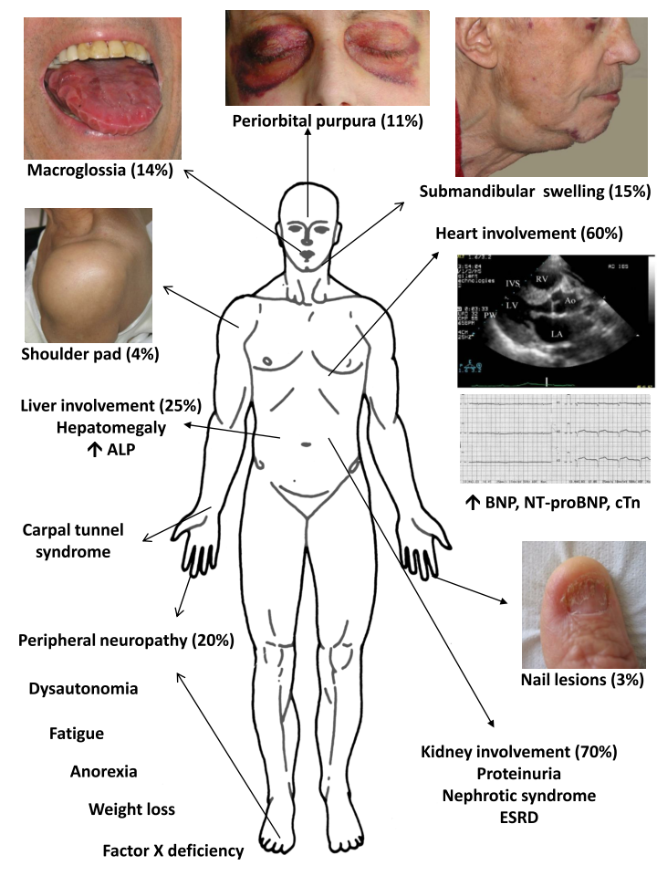
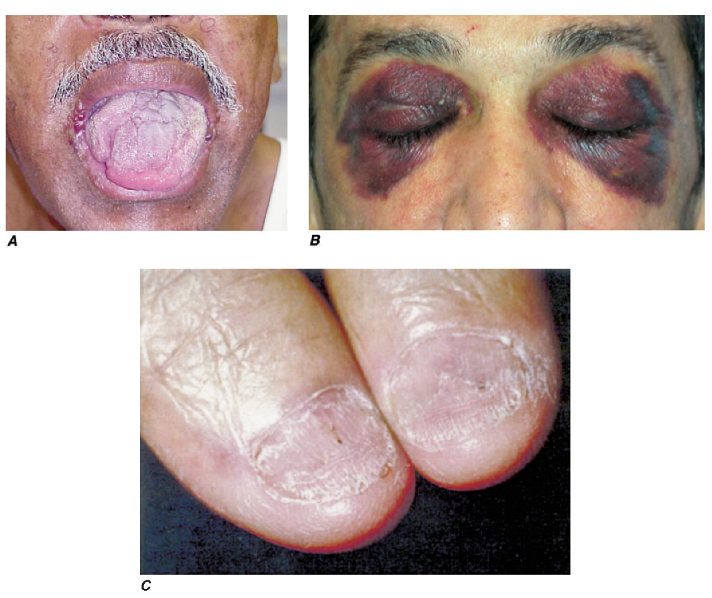
Systemic amyloidosis - 1
Typical clinical presentation:
multisystem
nephrotic syndrome, cardiac, peripheral nerve
beware of external signs - relatively rare but can be very helpful: macroglossia, periorbital purpura, submandibular swelling, shoulder pad, nail lesions
2. Epidemiology:
- rare, underdiagnosed
Macroglossia
Periorbital ecchymoses
Fingernail dystrophy

Slide 11
Systemic amyloidosis - 2
3. Etiology/pathogenesis: protein folding disorders - β pleated sheet
- plasma cell dyscrasia, AL (light chain derived)
- underlying chronic inflammation, AA amyloidosis
- genetic predisposition: mutation in the amyloidotic protein
Dyscrasia:
Greek, dys, bad, krasis, mingling, “bad mixture”, an abnormal condition or disordered state; disorder of the blood,
Dyscrasia (or dyskrasia) ancient Greek medicine, meaning bad mixture of bodily fluids
eucrasia is health as a condition of harmony or balance

Slide 12
Simplified classification of the Plasma Cell Dyscrasias
 | Multiple Myeloma | MGUS: monoclonal gammopathy of undetermined significance
Bone marrow monoclonal plasma cells | ≥10% | <10%
Monoclonal protein serum and/or urine | ≥30g/L | <3.0g/L
hypercalcemia | + | -
renal insufficiency | + | -
anemia | + | -
bone lesions | + | -
MGUS = the most common of plasma cell dyscrasias, cause unknown
monoclonal immunoglobulin in serum/urine without multiple myeloma/other lymphoproliferative disorders
patients with MGUS are conservatively treated and do not need chemotherapy
premalignant plasma-cell proliferative disorder associated with a life-long risk of progression to multiple myeloma

Slide 13
Multiple myeloma =
plasma cell malignancy
Plasma cell dyscrasia =
low plasma cell burden
small but dangerous clone!
chemotherapy + stem cell
transplantation
Clone size
Clinical manifestations
due to clone
monoclonal immunoglobulins,
aka “paraproteins”
detectable in the blood or urine
Bone lesions
Hypercalcemia
Infections
Systemic symptoms
none
Clinical manifestations
due to paraprotein
Light chain cast nephropathy
Hyperviscosity
Amyloidosis (10-15% of AL amyloidoses)
Amyloidosis AL (85% of AL amyloidoses)

Slide 14
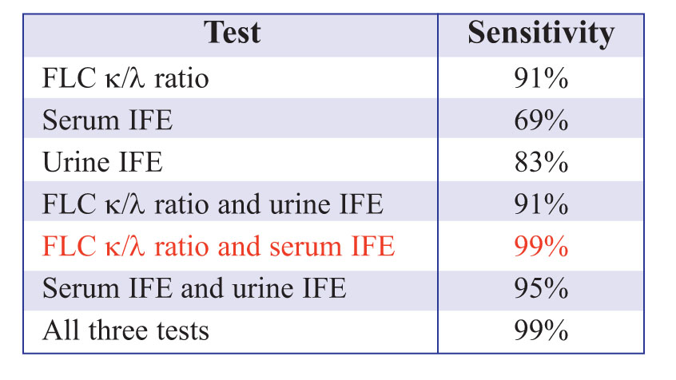
SFLchains:
much shorter half-life in the circulation than intact immunoglobulins
monitoring of responses to chemotherapy
in renal insufficiency – κ/λ ratio
Sensitivity of different diagnostic tests and their combinations in 110 patients with
AL amyloidosis at the time of disease diagnosis
(AR Bradwell, Serum free light chain analysis)

Slide 15
AL – amyloid Light chain derived from immunoglobulin light chain
Clonal proliferation of plasma cells synthesizing abnormal immunoglobulin
- plasma cell dyscrasia (low tumor burden) aka “primary”, ca 85% of AL
“small dangerous clones”
- multiple myeloma (plasma cell malignancy) 5-15%
- derived from immunoglobulin λ or κ light chain, λ > κ
- intrinsic properties of the light chain rendering them amyloidogenic

Slide 16
AL = amyloidosis derived from immunoglobulin light chain:
most prevalent type of systemic amyloidosis in the developed world (85%)
2,000 – 3,000 new cases each year in the US
clonal plasma cell proliferation
monoclonal protein in blood and deposits are systemic
aggressive chemotherapy with stem cell rescue; newer therapies
nephrotic syndrome
70%
60%
heart failure
arrhythmias
Amyloidosis in plasma cell dyscrasia/multiple myeloma
From: Amyloid and related disorders in Surgical Pathology, Picken et al, 2nd ed, Springer 2015
http://www.springer.com/medicine/pathology/book/978-1-60761-388-6

Slide 17
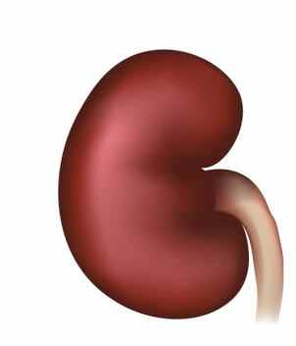
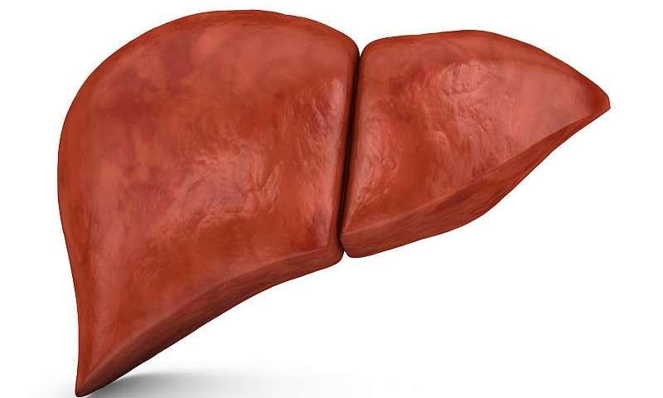
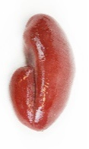
Reactive systemic amyloidosis – AA amyloidosis
derived from SAA protein (serum amyloid A protein)
secondary to associated inflammatory condition
long standing inflammation leads to a sustained elevation of SAA levels
rheumatoid arthritis, inflammatory bowel disease (Crohn’s diseases),
heroin abusers, “skin-poppers”, chronic infections in underdeveloped countries
deposits mainly in kidneys, liver, spleen
Familial AA:
Familial Mediterranean fever [FMF] – autosomal recessive
autoinflammatory disease caused by mutations in MEFV gene, which encodes pyrin
(involved in the regulation of innate immunity)
excessive production of cytokine IL-1 in response to inflammatory stimuli
episodic attacks of fever accompanied by inflammation of serosal surfaces
pleuritis, peritonitis, “polyserositis”, arthritis,
FMF usually occurs in people of Mediterranean basin origin: Sephardic Jews, Armenians,
Arabs, Greeks, Turks, Italians

Slide 18
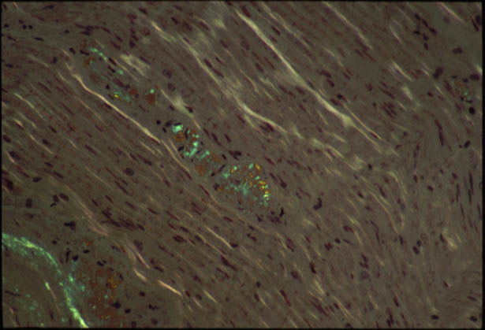
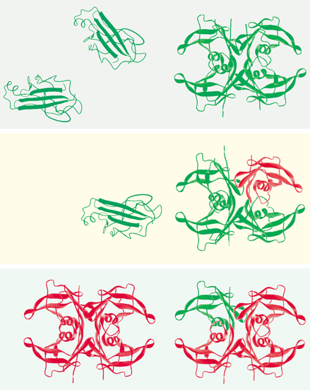
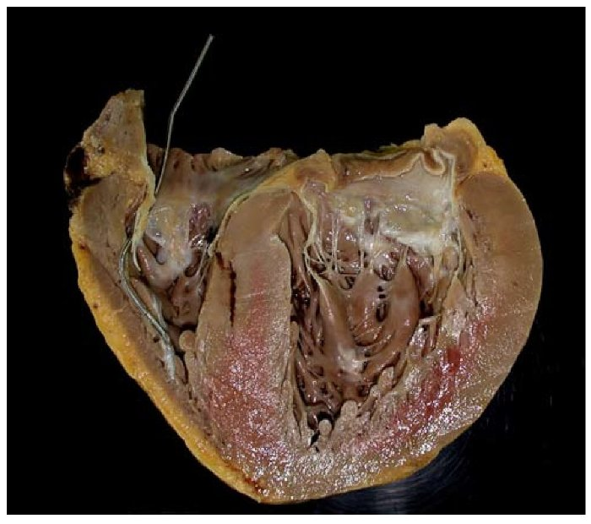
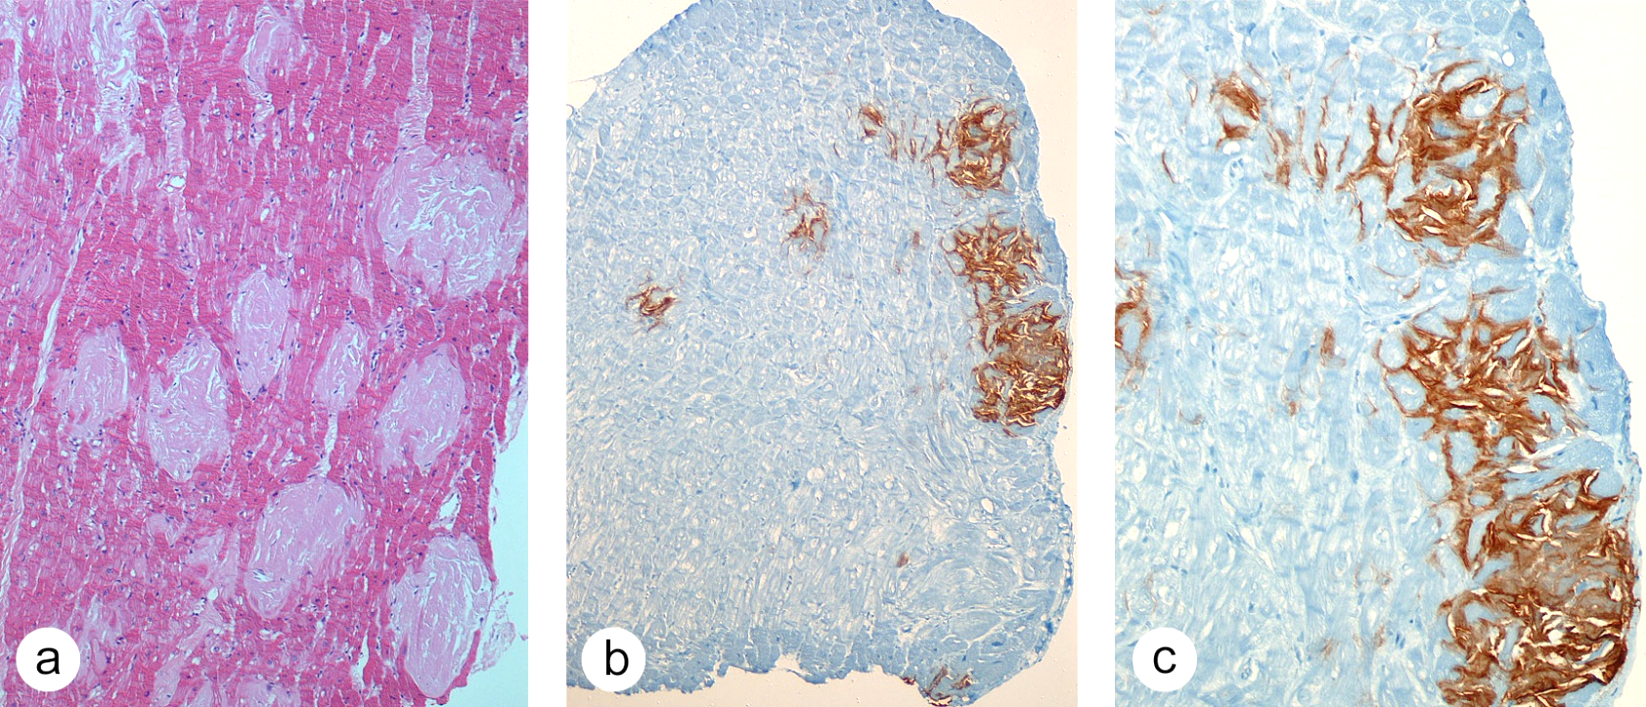
Hereditary: ATTR, AFib, AApoAI, AII, C-III…
Amyloidosis derived from transthyretin: ATTR
TTR circulates as tetramer, transport of thyroxin & retinol (vitamin A)
inherited mutation destabilizes tetramer
>95% liver; choroid plexus, eye
>100 mutations
polyneuropathies (sensory, autonomic), cardiac
gastrointestinal, some kidneys
“hot spots”: Portugal, Sweden, Japan but also worldwide
The most common hereditary amyloidosis in the US
~4% of African Americans (TTR V122I)
Variable penetrance
Late onset in some
Family history often missing
Can MIMICK AL – danger of misdiagnosis
Peripheral nerve with amyloid
*
enlarged heart, * deposits of amyloid

Slide 19
Pathogenesis of amyloidosis
INCREASED PRODUCTION OF PRECURSOR |  | NORMAL PRODUCTION OF MUTANT
Acquired mutations leading to Intrinsic instability | Chronic inflammation | Transthyretin (TTR) Mutation increasing instability
Monoclonal plasma cells | Macrophage activation IL1 & IL6 | mTTR…….
Immunoglobulin light chain | increased SAA protein
incomplete proteolysis | incomplete proteolysis
aggregation | aggregation | Aggregation
AL amyloidosis | AA amyloidosis | ATTR amyloidosis

Slide 20
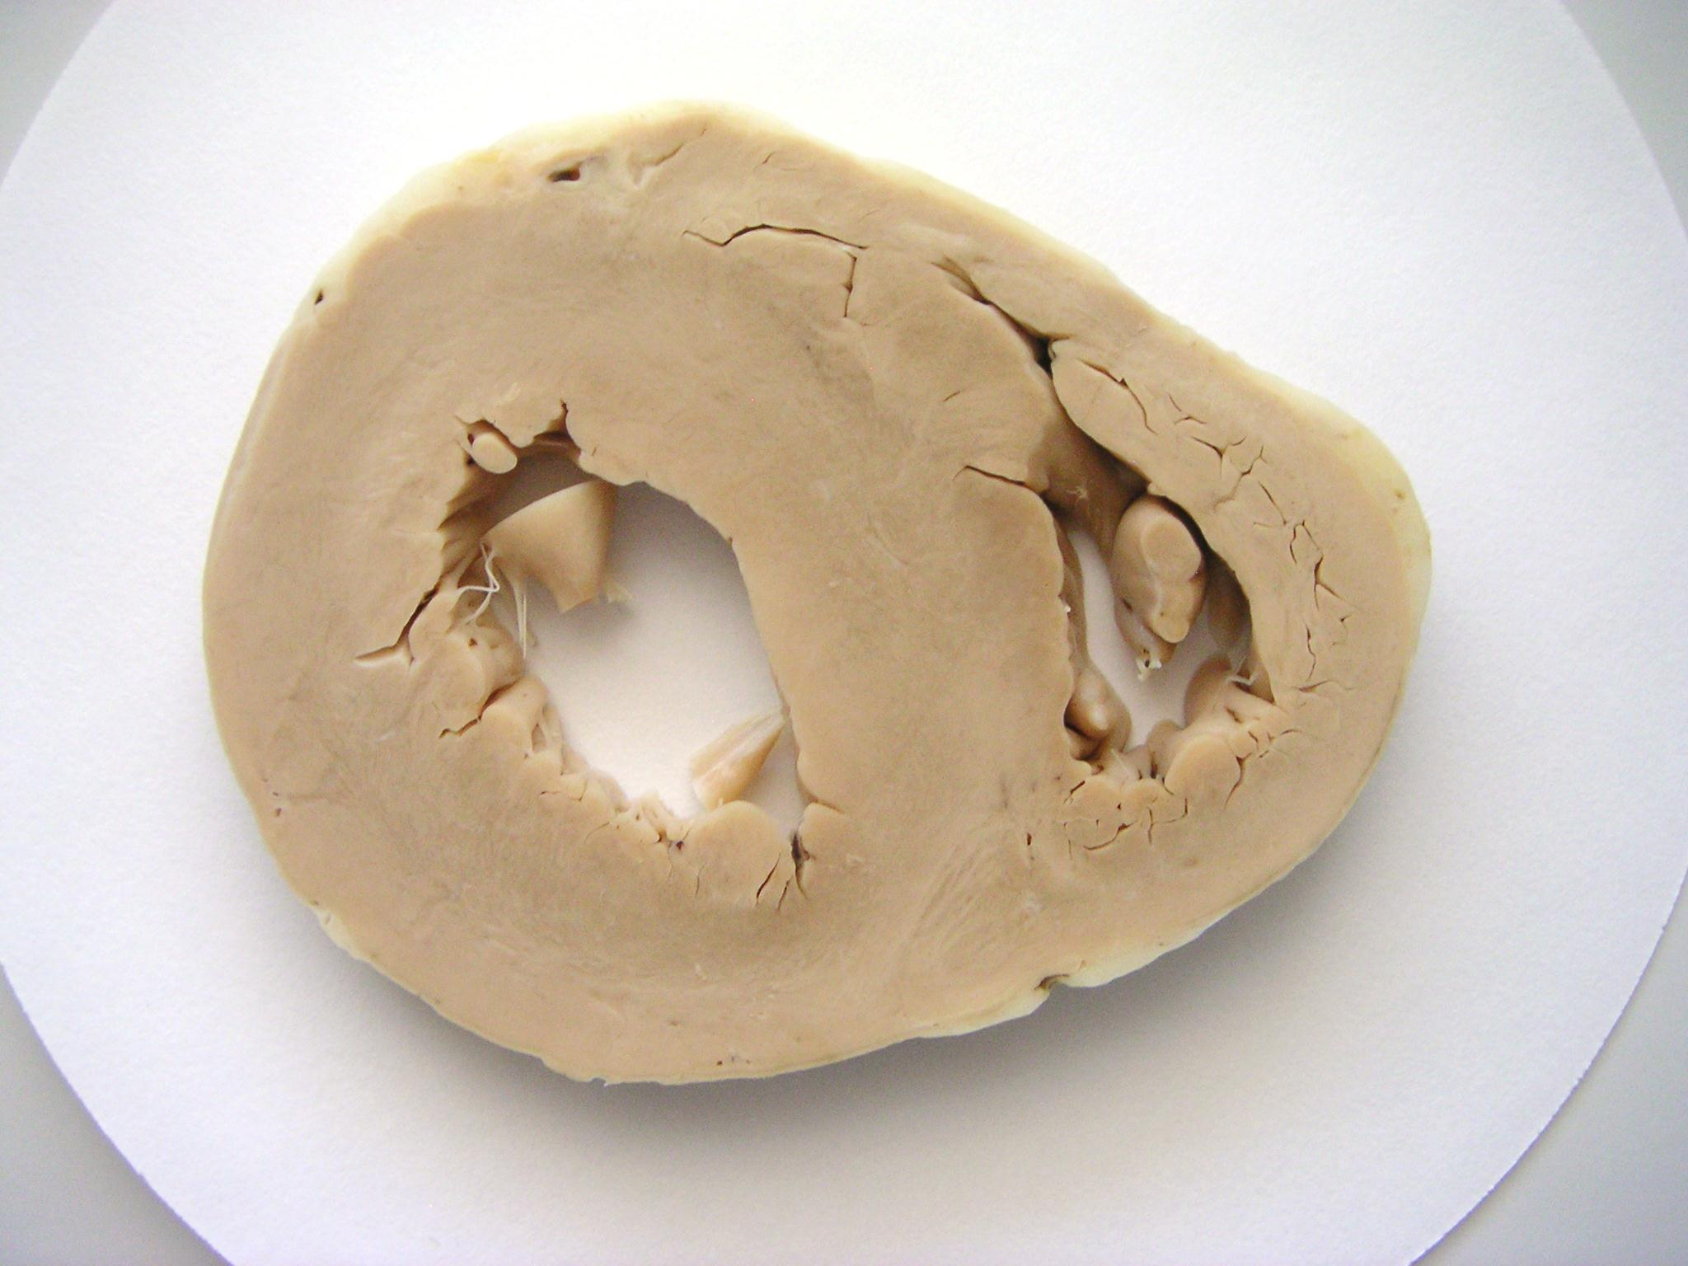
ATTRwt (wild type):
normal (wild type) transthyretin
is prone to fibrillogenesis at older age
- cardiac amyloid at old age
“cardiac Alzheimer”
Formerly SSA: senile systemic amyloidosis
males,
under-diagnosed – 25% of octogenarians
risk factors?
prevention?

Slide 21
Other amyloidosis types:
ALect2: amyloid derived from leukocyte chemotactic factor 2
- renal and systemic
- slowly progressing
- Mexican Americans, worldwide?
- no treatment, avoid misdiagnosis as AL
Hemodialysis-associated amyloidosis:
- derived from β2-microglobulin (not effectively removed by dialysis)
- long term hemodialysis
- periarthritis, carpal tunnel syndrome, tenosynovitis
- incidence decreased with newer dialysis membranes
- kidney transplantation
Localized amyloidosis:
lung, larynx, skin, urinary bladder; mostly AL
Iatrogenic: insulin injection site
surgical treatment
Endocrine amyloid, certain tumors….

Slide 22
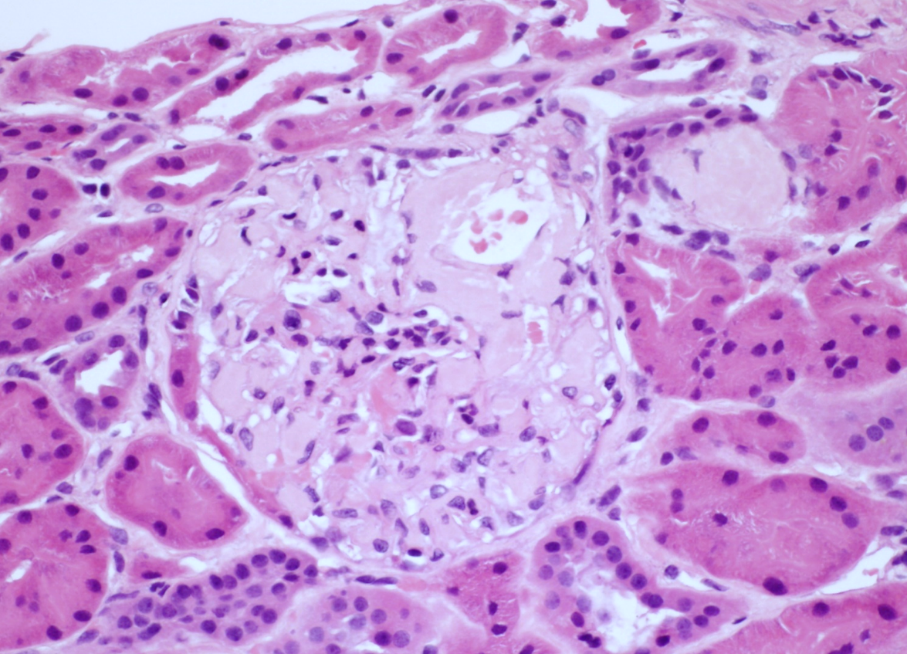
Systemic amyloidosis - 3
4. Pathology:
kidney involvement in 70%
Cardiac in 70%
peripheral nerves, other sites
In H&E more advanced deposits of amyloid appear
as eosinophilic, amorphous, “hyaline” material,
always the same, regardless of the type of amyloid
Early amyloidosis may be indistinguishable from minimal change disease, FSGS or diabetes. Therefore Congo red stain must be examined to rule out amyloid and not just to confirm suspicion of amyloid based on routine H&E stain

Slide 23
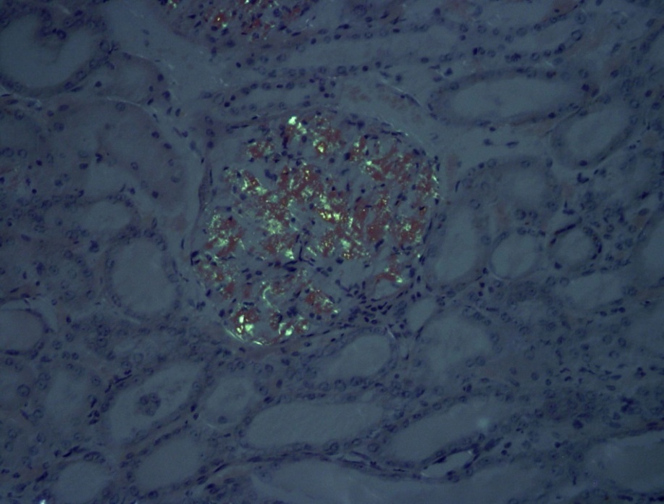
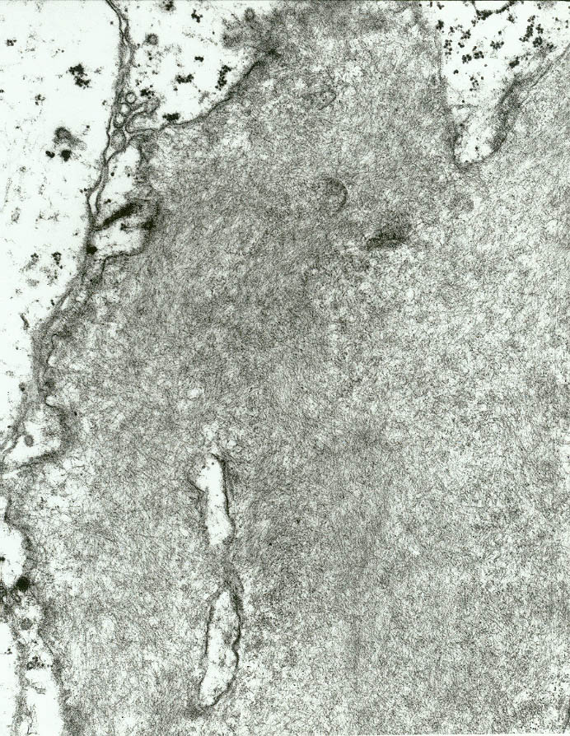

Systemic amyloidosis - 4
5. Laboratory tests:
- tissue diagnosis
hence a biopsy of an affected organ or a “surrogate” site
think – amyloid
order Congo red stain
Routine stain: extracellular “amorphous” deposits,
not-specific for amyloid
Need Congo red stain with green birefringence under polarized light
[“apple green” birefringence] = diagnostic
Amyloid is fibrillary only
by electron microscopy

Slide 24
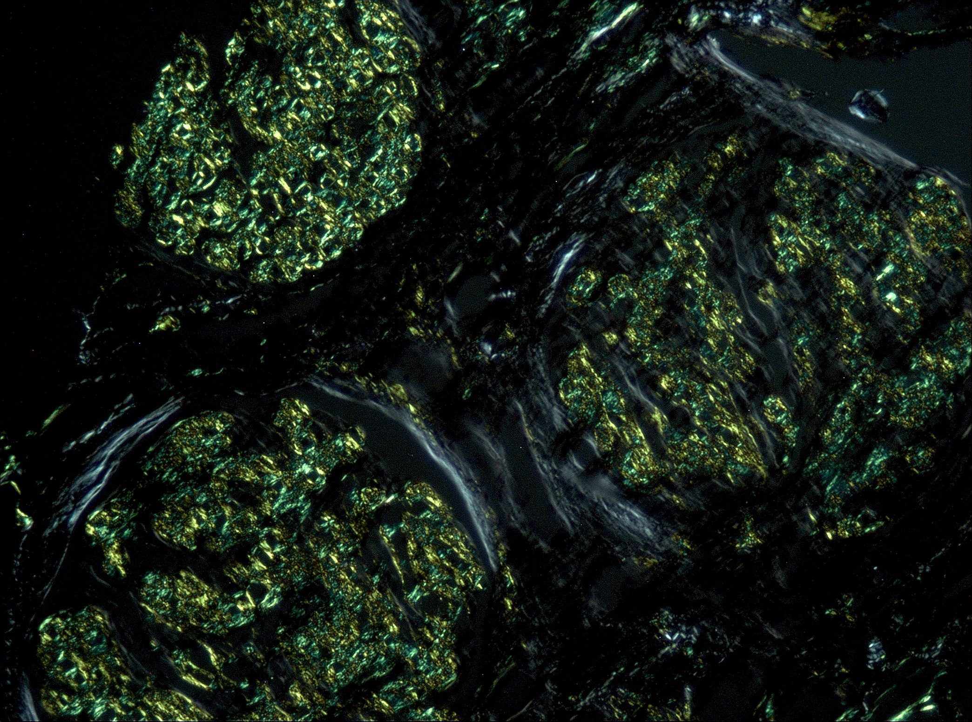
You need to think about amyloid
and do special stain -
Congo red
Clinical suspicion…
Pathologic suspicion…
Challenges in early diagnosis…
Congo red stain with green birefringence under polarized light – diagnostic of amyloid

Slide 25
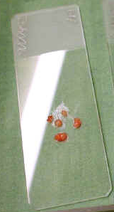
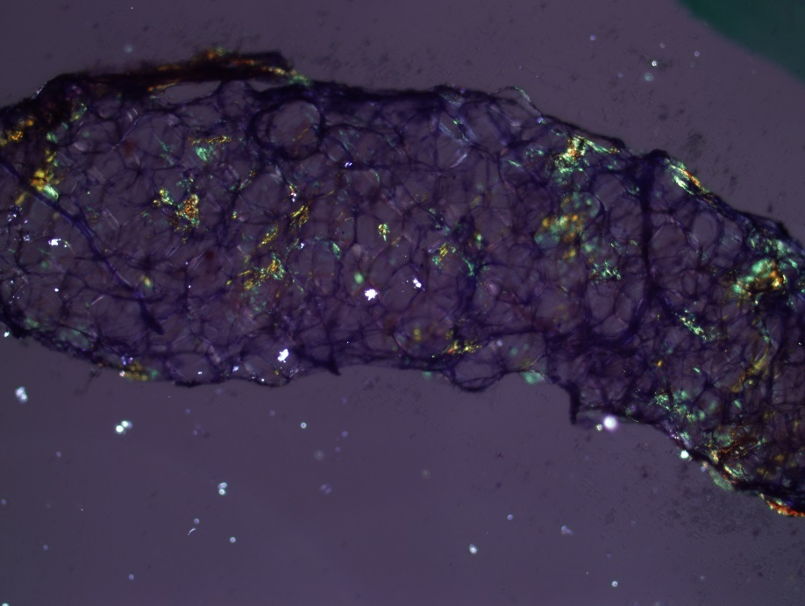
“Surrogate” site biopsy
Amyloid can be detected in subcutaneous fat
Fat biopsy typically from periumbilical abdomen (“surrogate site”)
for diagnosis and screening of patients at risk (i.e. known plasma cell dyscrasia)

Slide 26
Differential diagnosis of
of proteinuria/nephrotic syndrome in adults:
Focal and Segmental Glomerular Sclerosis/Minimal change disease
Membranous nephropathy
Diabetes
Amyloidosis!!!
Cardiac amyloidosis – heart failure, arrhythmia, long list of differential
Polyneuropathy – sensory and autonomic disturbances, long list of differential
Amyloid deposits are unevenly distributed in tissues

Slide 27
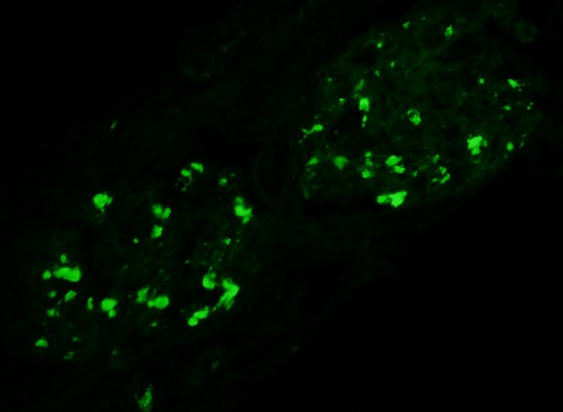
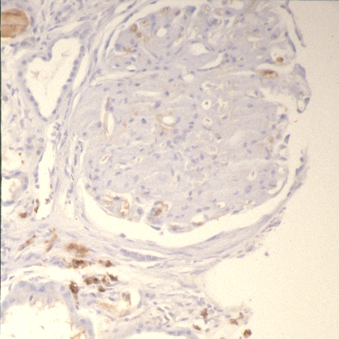
Systemic amyloidosis - 5
6. Prognosis:
- amyloid type and stage dependent, delay in diagnosis…
Amyloid typing: immuno stains & proteomics
Immuno stains: need to know what amyloid type to look for & need to have the required antibody

Slide 28
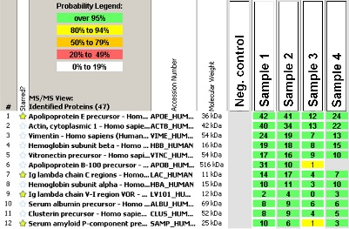
Proteomics: the large-scale study of proteins
sections stained with Congo red
are laser micro-dissected
Protein extraction,
Trypsin digestion into peptides
HPLC: separation of peptides
+
+
ESI: peptides are ionized +++
+
++
Peptides sprayed into MS1:
measures the parent mass of the peptide and
selects the peptides for CID (collision-induced dissociation)
+
+
+
++
Global identification of proteins!
CID: upon collision with a neutral gas, the peptides are fragmented
MS2:
- measures the size of each fragment derived from the parent peptide mass
- these measurements are used to predict the amino acid sequence

Slide 29
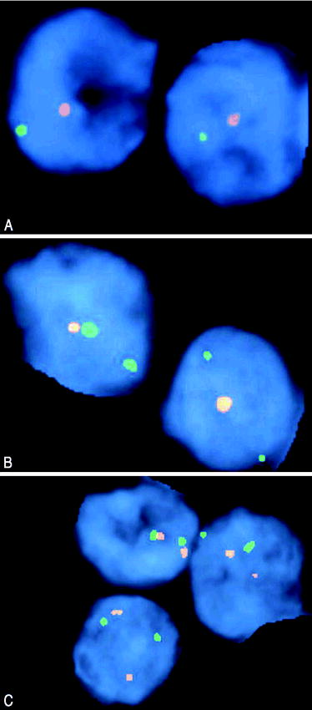
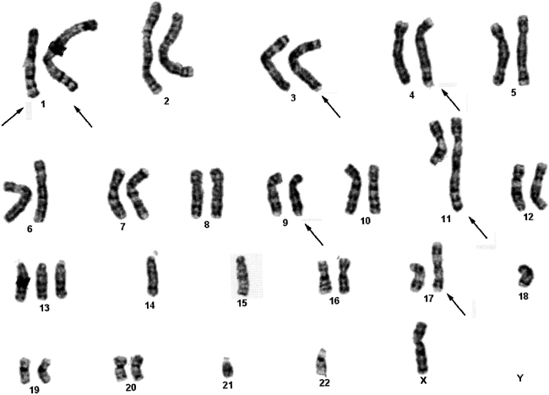
Antibody versus mass spectrometry
FISH: fluorescence in-situ
hybridization
Conventional cytogenetics

Slide 30
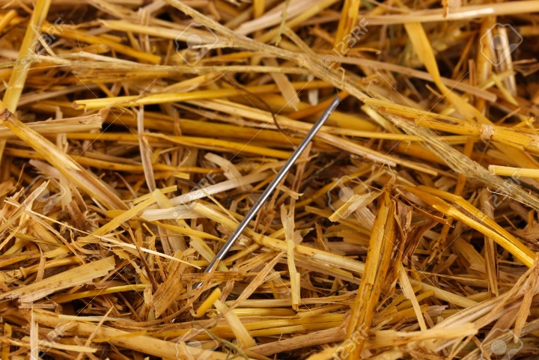
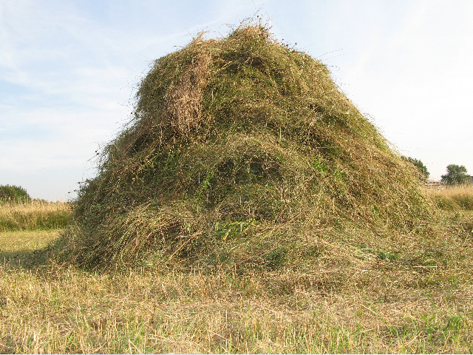
Proteomics
- limitations:
It may be difficult to detect low abundance proteins/peptides as signals from these peptides may be
buried among massive amount of information obtained from more abundant proteins
- advantages:
global identification of proteins
discovery of unsuspected proteins

Slide 31
Systemic amyloidosis - 6
7. Treatment: amyloid protein type dependent

Slide 32
Renal Amyloidoses – protein types and treatment options
AL: ~85%
Non-AL: ~15%
AA:
- derived from SAA (serum amyloid-associated)
- pathogenesis:
chronic inflammation, sporadic or familial
- treatment: anti-inflammatory
ALect2: derived from
leukocyte chemotactic factor 2
- pathogenesis?
- no specific therapy
- derived from immunoglobulin light chain
- pathogenesis: clonal plasma cells proliferation
- treatment: anti-plasma cell therapies…
hereditary: avoid misdiagnosis as AL!
- derived from various mutant proteins; transthyretin, fibrinogen, other
- liver transplantation
- clinical trials (transthyretin amyloidosis)
- genetic testing

Slide 33
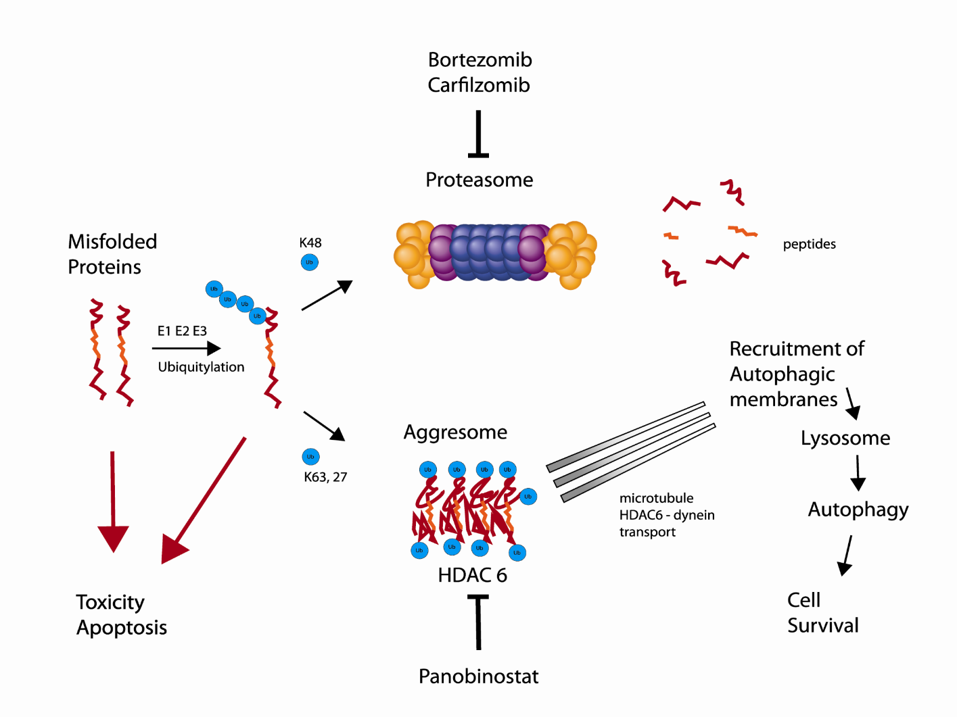
AL:
chemotherapy + stem cell
transplantation
Proteasome inhibitors
Effective therapies available
Durable responses achievable
Late diagnosis =
major obstacle!!!
proteasomes: protein complexes which degrade unneeded or damaged proteins by proteolysis
located in the nucleus and the cytoplasm.

Slide 34
AA amyloidosis
treatment of inflammation
↓
reduction of SAA
↓
increased survival
<10mg/l
10-50mg/l
>50mg/l
Not all patients with chronically elevated SAA
develop AA amyloidosis - ? genetics
Lachmann et al
Notes:
34

Slide 35

Reactive systemic amyloidosis – AA amyloidosis
- disease-modifying antirheumatic drugs (DMARDs)
- biological response modifiers (biologics), genetically engineered to act like natural proteins in immune system,
work on specific targets instead of the whole immune system, fewer side effects,
used effectively as part of a combination treatment
Familial AA
FMF:
- Colchicine (from crocuses) primarily as a prophylactic treatment preventing attacks
- inhibits microtubule polymerization (essential to mitosis), effectively functions as a "mitotic poison" or mitosis-inhibitor

Slide 36
Hereditary Amyloidosis treatment
>95% of transthyretin
is produced by the liver
ATTR: the presence of a mutant leads to formation of unstable tetramers with oligomers dissociating and undergoing fibrillogenesis
- small molecules stabilizing tetramers in clinical trials….
- TTR gene silencing agents (FDA approved in 2018) reduce the amount of circulating TTR: siRNA (small interfering RNA) and ASOs (antisense oligonucleotides)
Hereditary amyloidosis – ATTR
amyloid is derived from transthyretin mutant, hence liver transplantation as “surgical gene therapy” to stop the supply of mutant…
Early diagnosis of amyloidosis = biggest challenge

Slide 37


The big picture -
where does amyloid fit?

Slide 38
What does antibody, Alzheimer’s disease, aging and recycling
have in common?
- amyloid formation
Amyloid beyond disease:
- aging
- functional amyloid – “functional fold”

Slide 39
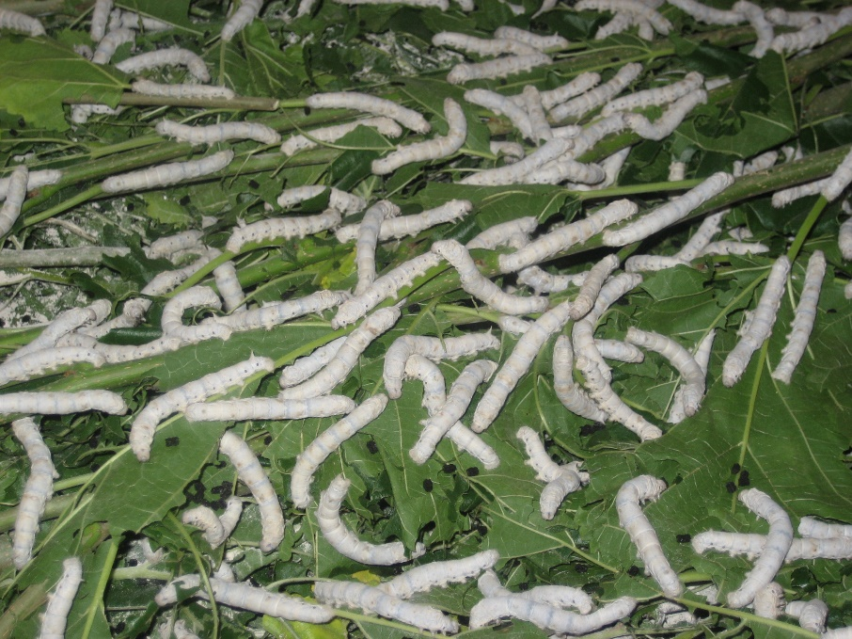

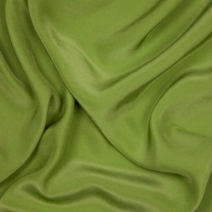
Images of amyloid

Slide 40
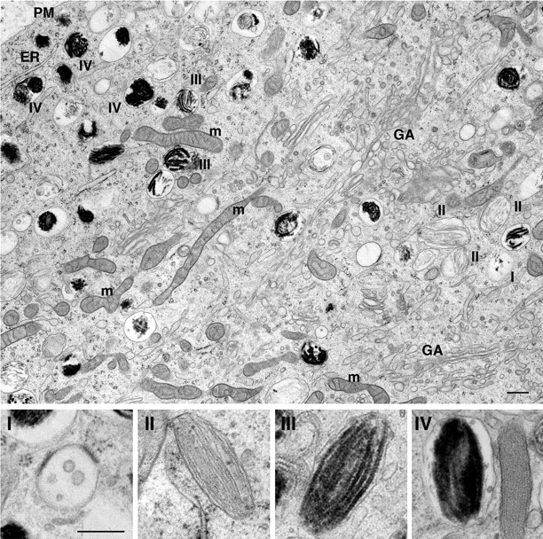
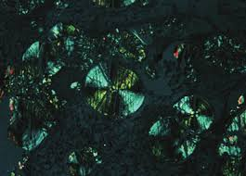
Amylome = the universe of proteins
that are capable of forming amyloid-like fibrils
Functional amyloid
Amyloid in nature for functional purposes
high-density packing of amino acids
unique mechanical or chemical properties
highly adapted use
bacterial biofilm, fungal spore production,
melanosome production in the skin, hormone packing
in the secretory granules of the endocrine system
natural adhesives that cure in different environments
including fully submerged in seawater
Mammalian protein Pmel17: forms amyloid structures and thereby accelerates covalent polymerization of reactive small molecules into melanin
peptide hormones stored as
amyloid-like cross-β-sheet-rich
conformations in pituitary glands

Slide 41


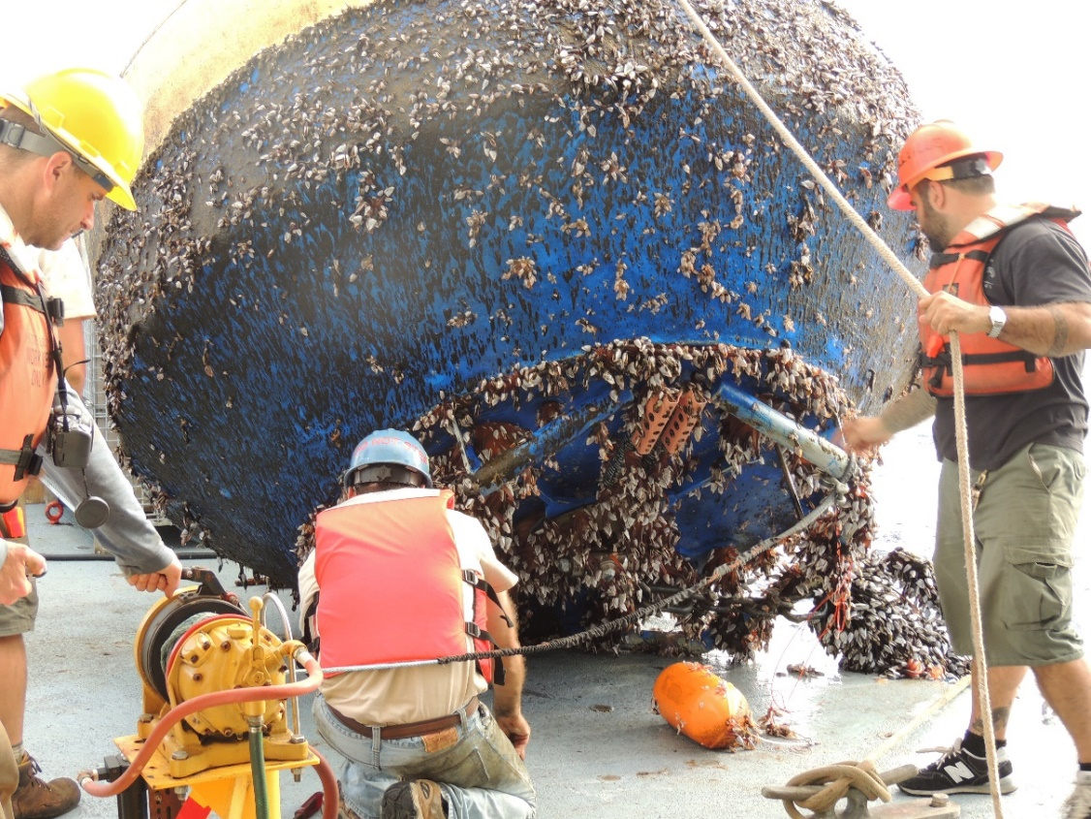
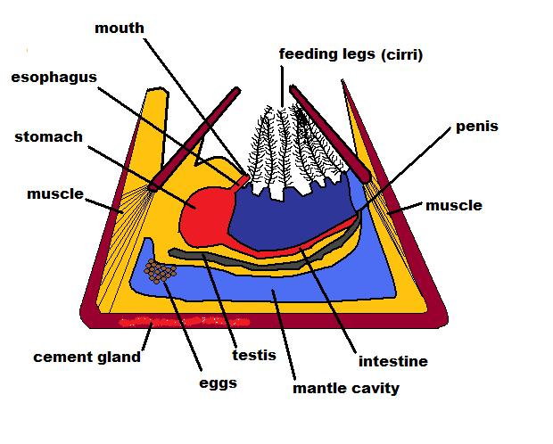
Barnacle (marine crustacean)
stick with amyloid adhesive

Slide 42
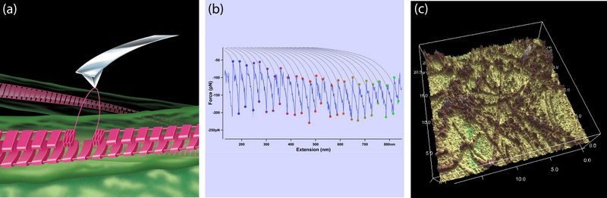
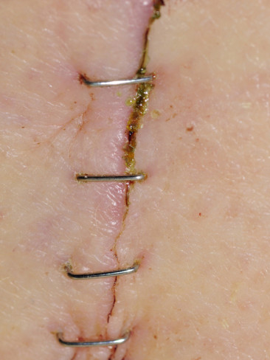
Amyloid fibrils as biotechnological role models…
“Functional fold”:
amyloid-based natural adhesives, biomimetic adhesives…
Schematic model of the mechanical manipulation of single intermolecular beta-sheets of an amyloid fibril by an AFM tip. The sequential unfolding of individual molecules corresponds to the repetitive sawtooth peaks in force-extension curves.
(b) Representative force-extension curve sawtooth from probing the adhesive of the aeroterrestrial green alga, Prasiola linearis. The regularly spaced, highly-ordered peaks have been fitted to the worm-like chain model.
(c) AFM image of functional amyloid fibrils in the adhesive extruded from the marine parasite, Entobdella soleae, which attaches to the skin of the common sole (Solea solea) in the marine environment. A. Mostaert et al.

Slide 43
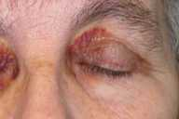
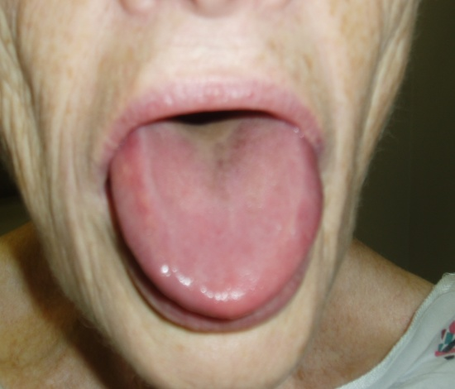
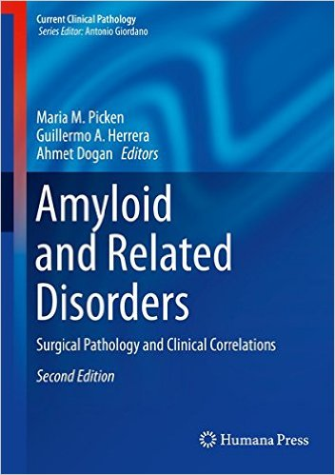
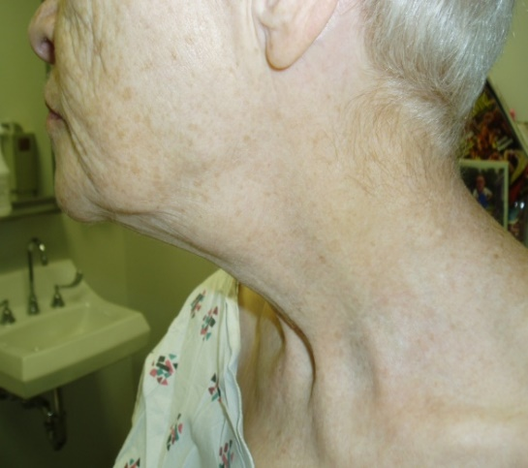
Thank you
Questions?
mpicken@lumc.edu
Clinical suspicion…
Pathologic suspicion…
Patients’ perspective…
Awareness and education

