Slide 1
ICU Subinternship
Orientation

Slide 2
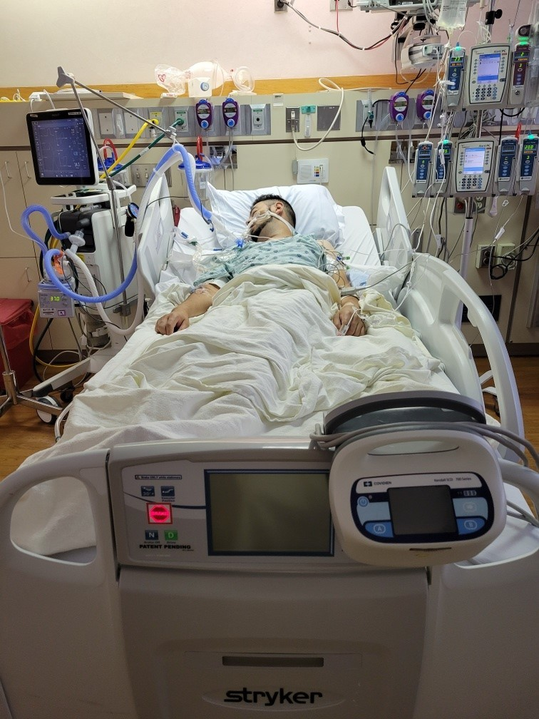
Welcome to the ICU

Slide 3
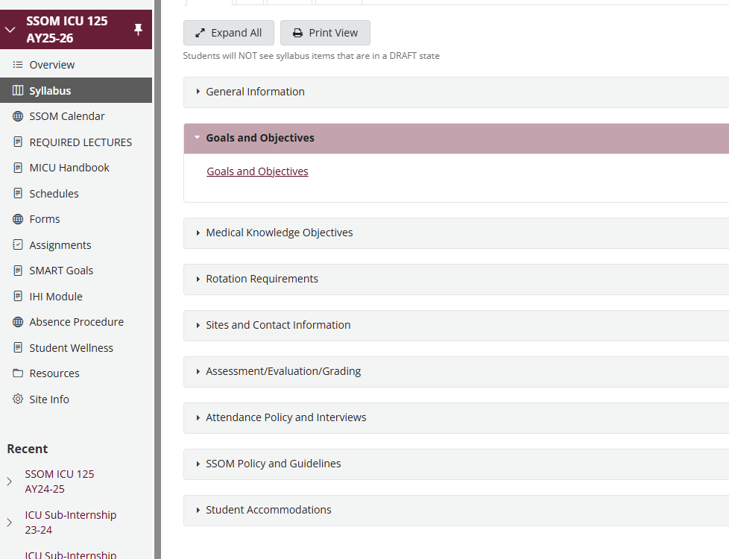
Goals and Objectives

Slide 4
Goals and Objectives
Show up
Be honest and professional
Recognize a sick patient
Know your limitations and ask for help
Understand the ddx of respiratory failure and shock and know how to treat it
Review the literature and BRING YOUR FINDINGS TO ROUNDS
YOU ARE THIS PATIENT’S DOCTOR

Slide 5
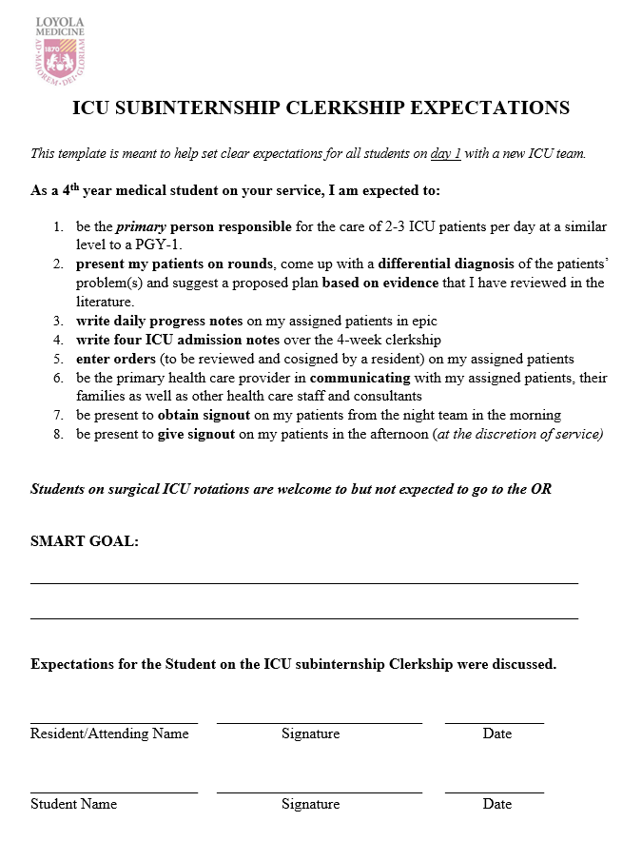
Student Expectations Card – new!

Slide 6
Rules
Attire
Scrubs are OK
Long coat to be worn over scrubs
Duty Hours
PGY-1 rules apply
Please email me if you find you are working more than 80 hours per week (on average)
Notes:
Last year, on the clerkship evaluation, a student reported one week of working over 80 hrs because he/she was “slow” and spent a long time writing notes and talking to families. Technically this doesn’t count as it is ON AVERAGE.

Slide 7
Attendance
Clinical Skills Day and Final exam day are REQUIRED
Even if scheduled for an away rotation
< 4 week rotation
Only 19-20 actual days in the ICU
4 days off
1 day off per week PLUS day prior to exam OFF
University Holidays are an extra day off:
July 4th Fall Break St. Luke’s Day ** at the discretion of hospital/service Veterans’ Day ** VA only - at the discretion of the service | Thurs/Fri of Thanksgiving Winter Break Martin Luther King, Jr. Day Match Day and the following weekend Spring Break Good Friday

Slide 8
Typical Schedule
Sunday | Monday | Tuesday | Wednesday | Thursday | Friday | Saturday
 | Clinical Skills Day
Day off
Day off
Day off |  |  |  | Day off | Exam | off
off

Slide 9
Interviews
During interview season, you are only allowed FOUR days off for interviews
For every day you need off for interviews, you will need to work both days on a weekend
If you need 3 weekdays off for interviews during the clerkship, this means you are working both days every weekend.
We allow one additional day without make up for interviews.
If your interview takes place in the morning and you will miss rounds, this counts as a day off
If your interview takes place in the afternoon and you have been present during rounds, written your notes and completed everything on your to-do list, you can be excused early and NOT use one of your days off for the interview

Slide 10
Interview Schedule
Sunday | Monday | Tuesday | Wednesday | Thursday | Friday | Saturday
 | Clinical Skills day
 |  |  | Interview | Interview
 | Interview |  |  |  | Interview
 |  |  |  | OFF | Exam | off
off

Slide 11
PICU Schedule
Sunday | Monday | Tuesday | Wednesday | Thursday | Friday | Saturday
 | Clinical Skills Day | 6a-6p (12 hours) | 6a-6p (12 hours) | 6a-6p (12 hours) | 6a-6p (12 hours) | 6a-11a (5 hours)
OFF | 6a-6p (12 hours) | 6a-6p (12 hours) | 6a-6p (12 hours) | 6a-6p (12 hours) | 6a-6p (12 hours) | 6a-11a (5 hours)
OFF | 6a-6p (12 hours) | 6a-6p (12 hours) | 6a-6p (12 hours) | 6a-6p (12 hours) | 6a-6p (12 hours) | OFF
6a-11a (5 hours) | 6a-6p (12 hours) | 6a-6p (12 hours) | 6a-6p (12 hours) | OFF (study day) | EXAM | OFF
Notes:
Average 56 hours per week
Two middle weeks is 65-68 (extra time needed for signout at 6pm)

Slide 12
Illness
Not feeling well?
If sick: Contact the Wellness Center immediately to set up an appointment to be excused. You need to provide documentation that you are ill. A follow up appointment is needed to document clearance to return to work.
Alert your site and your team that you will be absent
Send an E-mail to Dr. Gilbert and copy the office of student affairs and Vivian Ortiz with the reason for your absence
Students are allowed 2 days for illness.
If more than 2 days are needed, students will need to make up the missed days.

Slide 13

ICU Sub-I Core Curriculum
Prior to Day 1, review all lectures on Sakai
Shock (Dr. Emily Gilbert)
Respiratory failure and mechanical ventilation (Dr. Kevin Simpson)
Cardiology lecture (Dr. Subir Shah)
Nutrition case (Tamara Kinn, RD, LDN, CNSC)
Acid Base (Dr. Emily Gilbert)
In preparation for Clinical Skills Day:
Ethics (Dr. Paul Hutchison)
POCUS videos
Notes:
Utilizing communication strategies students learned during their recorded Ethics lecture, students role play a simulated sequence of family discussions related to the care of a decompensating patient

Slide 14
ICU Sub-I Core Curriculum
Clinical Skills Day – 1st day of clerkship
In person lectures:
Orientation lecture
Death and Dying lecture
Ethics role play/small group session
students role play a simulated sequence of family discussions related to the care of a decompensating patient
Simulation Sessions:
Hands on critical care ultrasound session
Simulation session: care of a critically ill patient
Hands on ventilator session with 3 different cases
Notes:
Based on feedback from last year’s class, we have added a voiceover power point lecture from our ICU dietician. You are NOT responsible for all of the information in the powerpoint but it is there for your reference.

Slide 15
Website/Resources
Loyola MICU lecture series
Schedule found in MICU

Slide 16
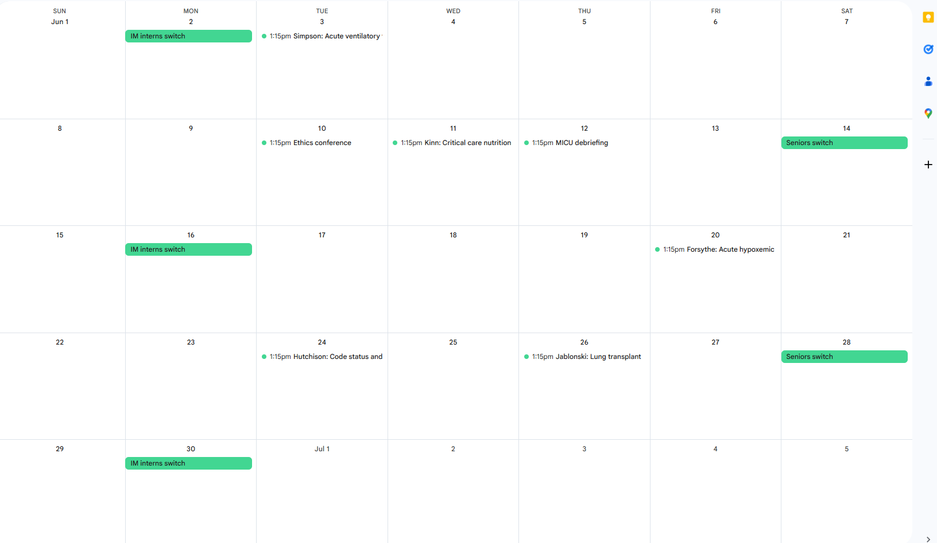

Slide 17

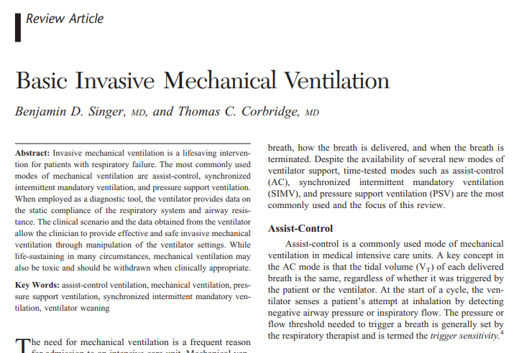
Additional Resources
Sakai
LUMEN
The ICU Book
Ventilator Basics

Slide 18
Medical Objectives

Slide 19
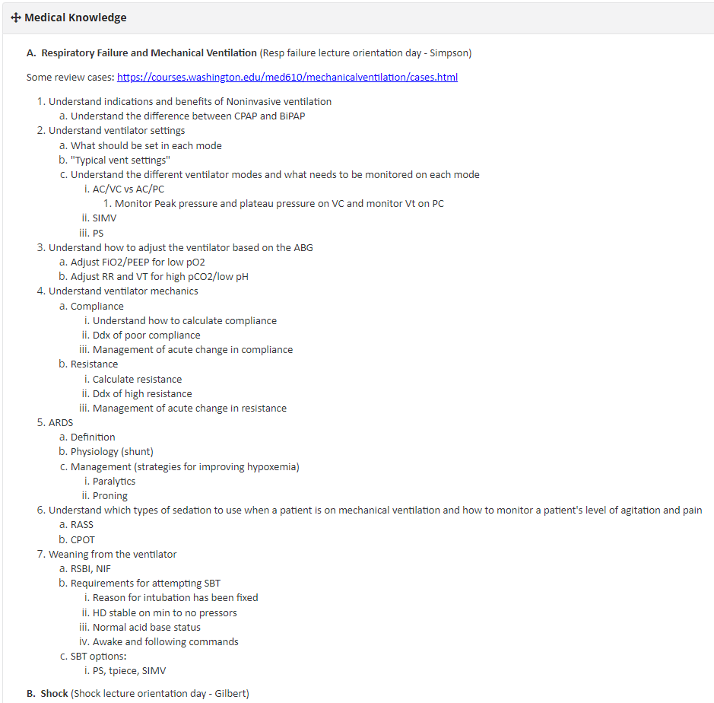
Goals and Objectives

Slide 20
Practice Exam questions
On sakai

Slide 21
Clinical Skills Day
Date | Time | Topic | Faculty | Room / Link
ONLINE CASES
Online – review prior to orientation day |  | Hemodynamic Monitoring and Shock * | Dr. Emily Gilbert (author) | Shock
Online – review prior to orientation day |  | Respiratory Failure and Mechanical Ventilation * | Dr. Kevin Simpson (author) | Respiratory Failure
Online – review prior to orientation day |  | Cardiac Issues* | Dr. Subir Shah (author) | Cardiac Issues
Online – review prior to orientation day |  | Nutrition in the Critically Ill Patient * | Tamara Kinn, RD | Nutrition in the Critically Ill Patient
Online – review prior to orientation day |  | Acid Base * | Dr. Emily Gilbert (author) | Acid Base
IN PERSON LECTURES
Clinical Skills Day | 9:30am - 10:00am | Orientation lecture | Dr. Emily Gilbert
Clinical Skills Day | 10:00am – 11:00am | Death and Dying in the ICU | Chaplains
Clinical Skills Day | 11:00am – 12:00pm | Advanced Topics in Critical Care Ethics* | Dr. Paul Hutchison
LUNCH BREAK
Clinical Skills Day | 1:15pm – 3:15pm | Clinical Skills Exercise* | IM Chiefs, fellows | SON 3511

Slide 22
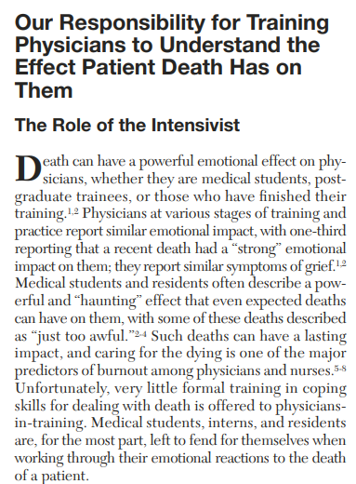

End of life, death and dying
Mortality in adult ICUs ranges from 30-50%
“How well do we do in teaching medical students and residents to understand the impact patient death has on them? Prior studies suggest that we are, in a word, abysmal.”
“Put bluntly, we abandon them during these emotionally challenging moments of coping with their reactions to death.”
“On the rare occasion when medical students report that an attending physician discussed the emotional aspects of a patient death with them, they find it very helpful and express deep appreciation.”

Slide 23
End of life, death and dying
Chaplain talk on Orientation day
MICU debriefing every month
Psychiatry comes to address the stress associated with caring for sick patients in the ICU
Discuss students’ and residents’ different coping mechanisms.
Attending or fellow
Notes:
One approach that has achieved success and sustainability is “Death Rounds.” In Death Rounds, trainees, faculty, and other members of the ICU team collaboratively review the deaths in the ICU in the preceding 1 to 2 weeks with a focus on how things went in the care of the patient and family as well as the influence of these deaths on us. The goal is not to fi nd fault but to create a safe environment where trainees can talk about their feelings and hear from others how they experience these deaths and how they keep patient deaths from having negative effects on the quality of their care, careers, and lives. If the faculty members are talking . 20% of the time during Death Rounds, they are missing the point of Death Rounds. T

Slide 24
ICU Sub-I Core Curriculum
To be completed prior to end of rotation:
SMART goal
A learning point that you would like to accomplish during your ICU clerkship.
Created and submitted by THIS Friday
If the goal is not submitted or is submitted late, this will be considered a concern for professionalism and practice-based learning clerkship competencies.

Slide 25
ICU Sub-I Core Curriculum
To be completed prior to end of rotation:
SMART goal
A learning point that you would like to accomplish during your ICU clerkship.
Created and submitted by THIS Friday
If the goal is not submitted or is submitted late, this will be considered a concern for professionalism and practice-based learning clerkship competencies.
Directly observed interpretation of a critical care CXR.
Filled out by your fellow or attending

Slide 26
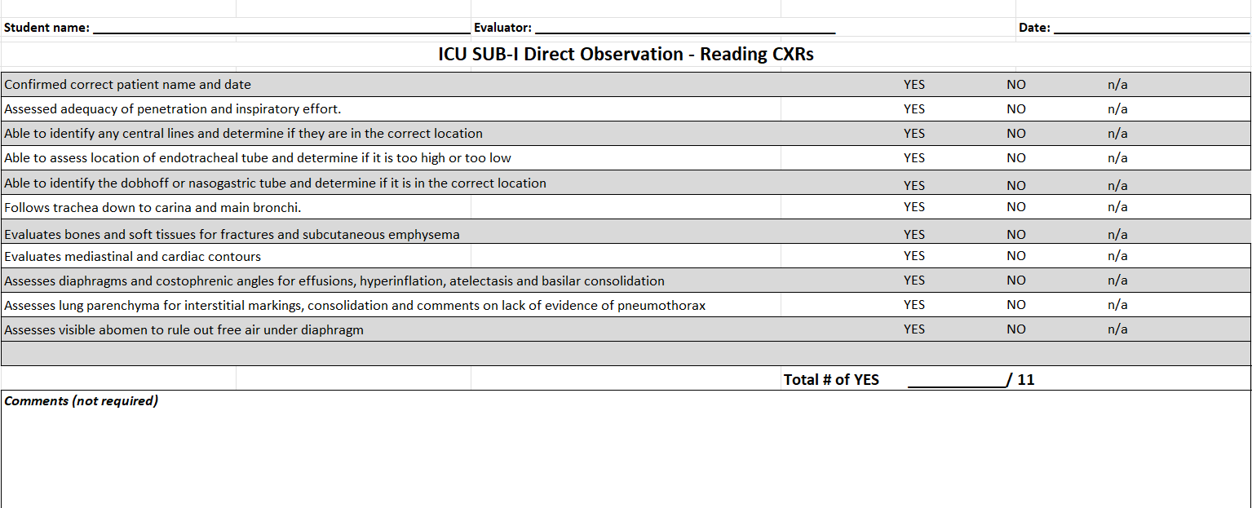
CXR interpretation
Needs to be filled out by ICU attending or fellow

Slide 27
ICU Sub-I Core Curriculum
To be completed prior to end of rotation:
SMART goal
A learning point that you would like to accomplish during your ICU clerkship.
Created and submitted by THIS Friday
If the goal is not submitted or is submitted late, this will be considered a concern for professionalism and practice-based learning clerkship competencies.
Directly observed interpretation of a critical care CXR.
Filled out by your fellow or attending
Directly observed POCUS activity.
Filled out by your fellow or attending

Slide 28
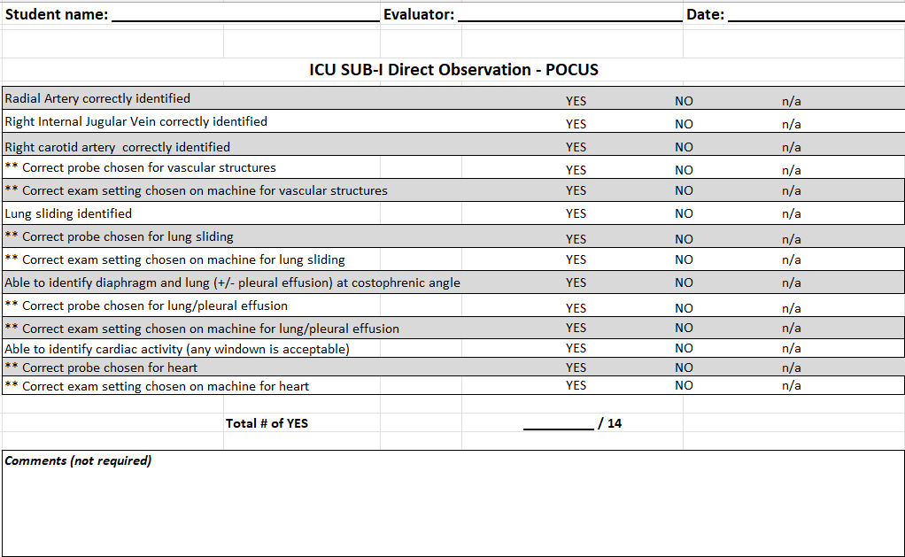
POCUS exam
Needs to be filled out by ICU attending or fellow

Slide 29
ICU Sub-I Core Curriculum
To be completed prior to end of rotation:
SMART goal
A learning point that you would like to accomplish during your ICU clerkship.
Created and submitted by THIS Friday
If the goal is not submitted or is submitted late, this will be considered a concern for professionalism and practice-based learning clerkship competencies.
Directly observed interpretation of a critical care CXR.
Filled out by your fellow or attending
Directly observed POCUS activity.
Filled out by your fellow or attending
Required Clinical Conditions Log
Due by the end of the third week of the rotation

Slide 30
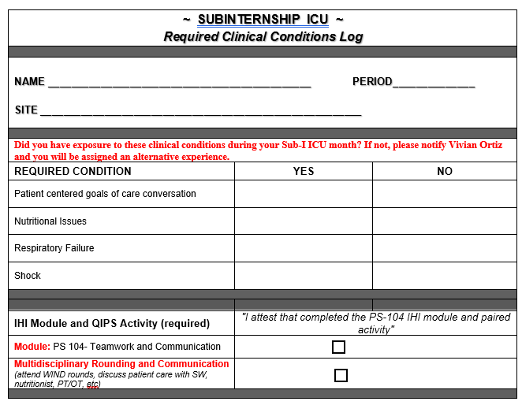

Slide 31
IHI Module and QIPS Activity Overview ICU Sub-I
Go to education.ihi.org and log in.
If you are not registered, you will need to set up an account using a “.edu” email account
Required Module: PS 104- Teamwork and Communication
Recommend completing the module early in the clerkship and prior to the paired patient centered activity to get the most educational benefit
Attest that you have completed this activity on the patient data log
Paired Activity: Multidisciplinary Rounding and Communication
Attest that you have completed this activity on the patient data log

Slide 32
ICU Sub-I Core Curriculum
To be completed prior to end of rotation:
SMART goal
A learning point that you would like to accomplish during your ICU clerkship.
Created and submitted by THIS Friday
If the goal is not submitted or is submitted late, this will be considered a concern for professionalism and practice-based learning clerkship competencies.
Directly observed interpretation of a critical care CXR.
Filled out by your fellow or attending
Directly observed POCUS activity.
Filled out by your fellow or attending
Required Clinical Conditions Log
Due by the end of the third week of the rotation
IHI module and paired activity
Mid-Clerkship Feedback and Self Assessment Form

Slide 33
Mid-Clerkship Feedback
Students are expected to fill out a self-assessment form and receive mid clerkship feedback
Use this time to discuss your clerkship SMART goal
Both forms should be handed into Vivian by the end of the second week of the rotation
Notes:
It is recommended by the subcommittee that student self-assessment forms be completed prior to the MCF event and preceptors’ review these forms to permit a discussion of the student’s perceived strengths and weaknesses in comparison to the preceptors’ opinions of the same

Slide 34
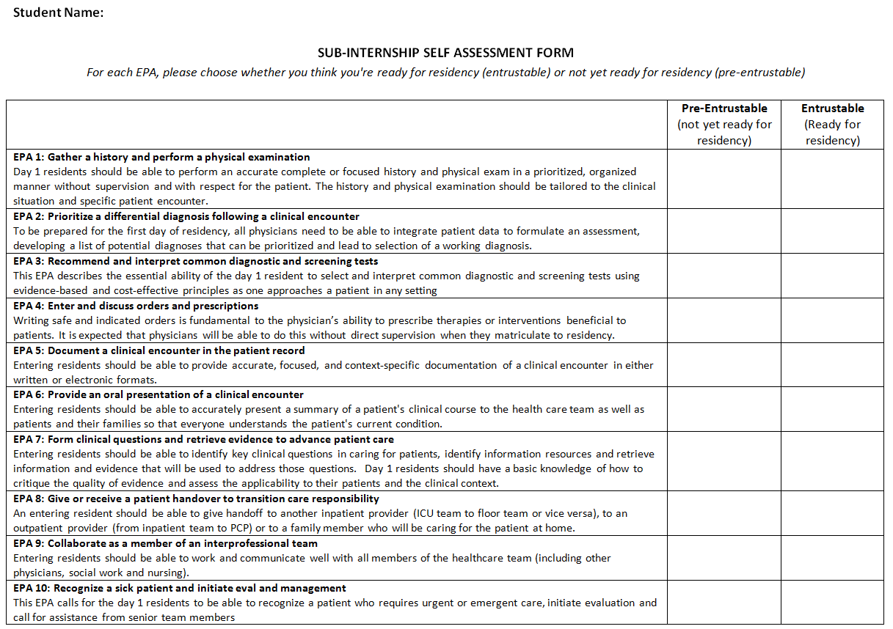

Slide 35
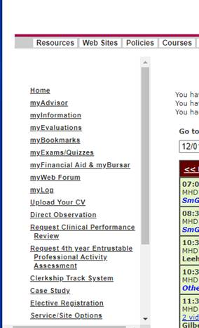

Clinical Performance Evaluation – MUST be filled out by an Attending
EPA-based
Log into myLUMEN and selecting “Request 4th year Entrustable Professional Activity Assessment”

Slide 36
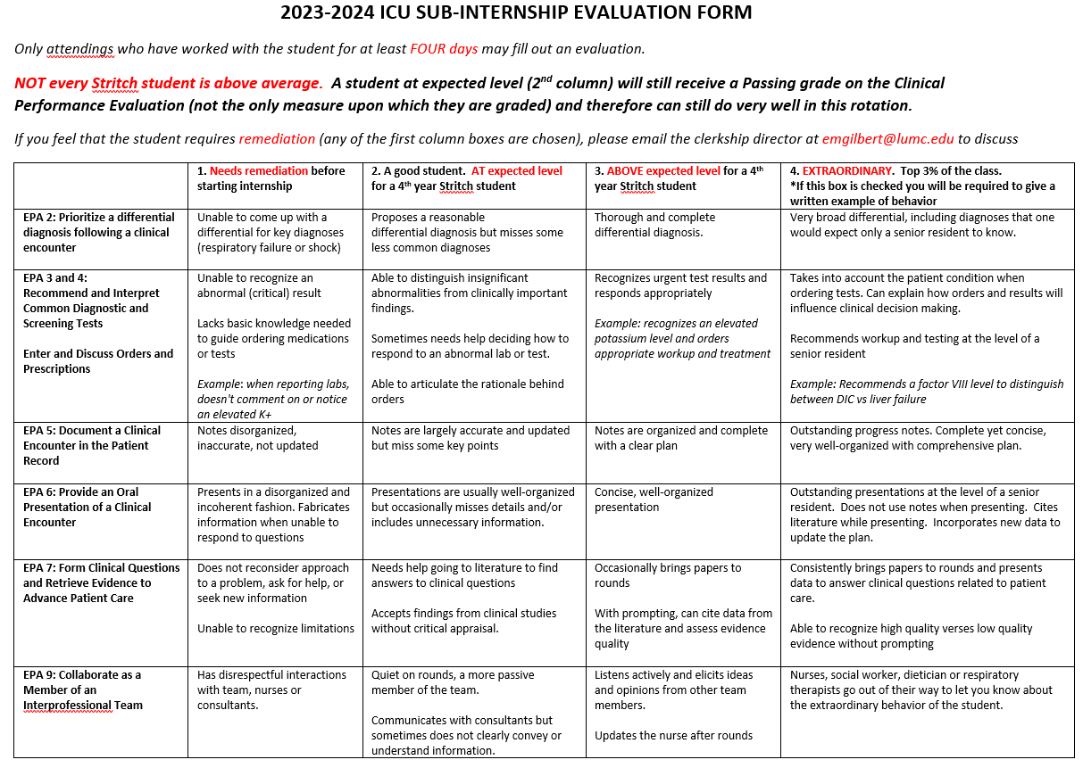
Notes:
Average CPE grade for 24-25 was 84% which is HP
Column 2 - 8.5
Column 3 – 10.5
Column 4 – 12.5
All column 2 = 68% (pass)
All column 3 = 84% (HP)

Slide 37
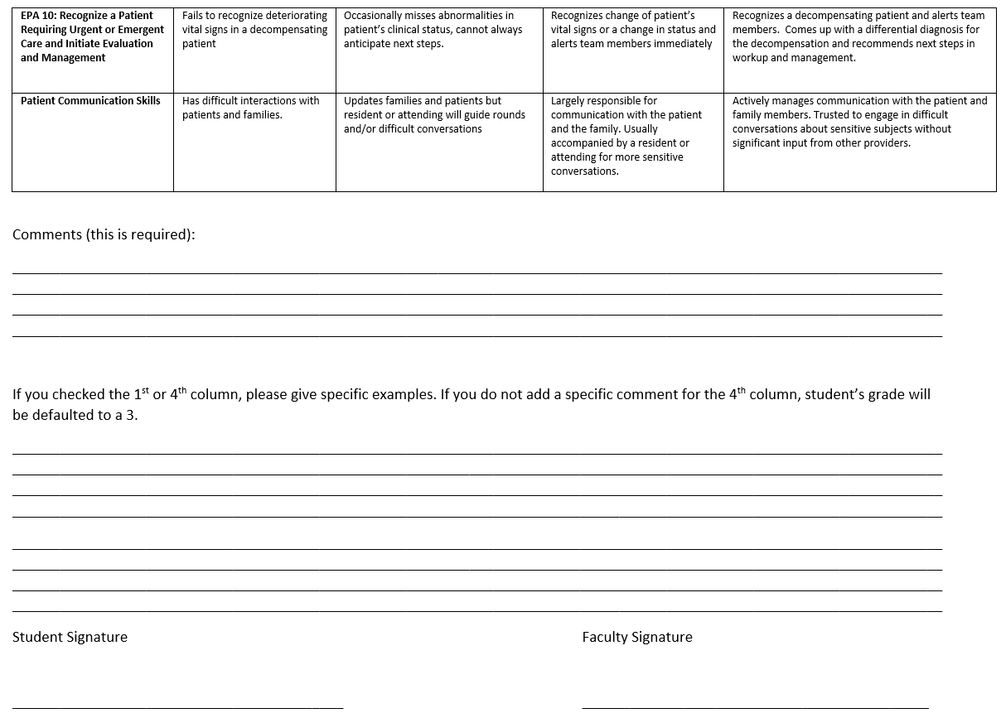

Slide 38
Clinical Performance Evaluation
EPA-based
Only 4 columns
If ANY box is checked within the 1st column, this means the student will require remediation
Dr. Gilbert or Dr. Hutchison will speak with evaluator
The 4th column should only be checked if the student is showing extraordinary behavior
An example will need to provided or we will default to column 3
Boxes checked in column 2 or column 3 is still a very good student
Notes:
Faculty will be sent instruction regarding the new evaluation form
Goal is to get this electronically delivered so no mistakes

Slide 39
Due Dates
Form | Due
Student Expectations form SMART Goals form Mid evaluation form Self-assessment form Required Clinical Conditions Log (online) IHI Module/attestation (online) Clinical Performance evaluation (online) Direct Observation CXR Directly Observed POCUS activity Online course evaluations | No due date end of 1st week end of 2nd week end of 2nd week end of 3rd week end of 3rd week end of rotation end of rotation end of rotation closes 2 weeks after end of rotation
All forms need to be uploaded under the Assignments Tab on Sakai

Slide 40
Grading
Component | Weight
Clinical Performance Evaluation | 40%
Exam | 30%
Clinical Skills Exercise: POLST | 10%
Directly observed: CXR interpretation | 10%
Directly observed: POCUS activity | 10%

Slide 41
Grading
Component | Weight
Clinical Performance Evaluation | 40%
Exam | 30%
Clinical Skills Exercise: POLST | 10%
Directly observed: CXR interpretation | 10%
Directly observed: POCUS activity | 10%
Cumulative Score:
HONORS: 89% - 100%
HIGH PASS: 84% - 88.9%
PASS: 60% - 83.9%
You must pass all components to pass the clerkship
Notes:
Cutoffs were determine based on last year’s grade (after adjusting with new weights and adding new POCUS activity)
Average grade after adjustments was 87%
Using a st dev of 3, honors cutoff determined to be 90% and HP cutoff 84%
After 3 cohorts, we will meet to review the grade distribution and adjust to achieve goal of 40% H, 30% HP and 30% P
Any adjustment will only give you a better grade – no one will be downgraded
We will evaluate the first two cohorts’ grades before ERAS opens at the end of September

Slide 42
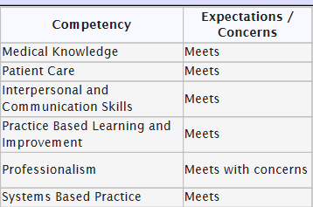
Professionalism is part of your grade!
Unprofessional behavior includes:
Not telling your team or the clerkship director about excused absences (interviews)
Taking more than the allowed number of days off
Not showing interest in rounds
Arriving late to lectures or rounds
Not turning in forms
Not filling out clerkship evaluation
Not completing SMART goal
If there are any professionalism concerns, the student will receive either a “meets with concerns” (for minor professionalism concerns) or a “does not meet” (for multiple episodes or a severe example of unprofessional behavior) under the professionalism competency.
If the student does not meet the professionalism competency, remediation will be required.

Slide 43
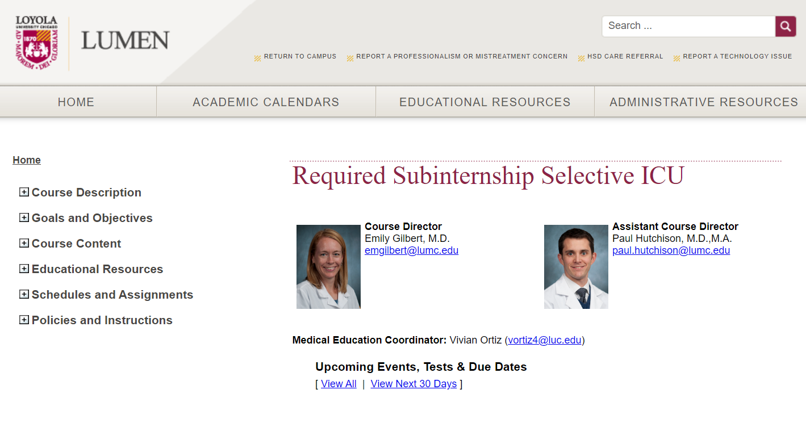

Slide 44
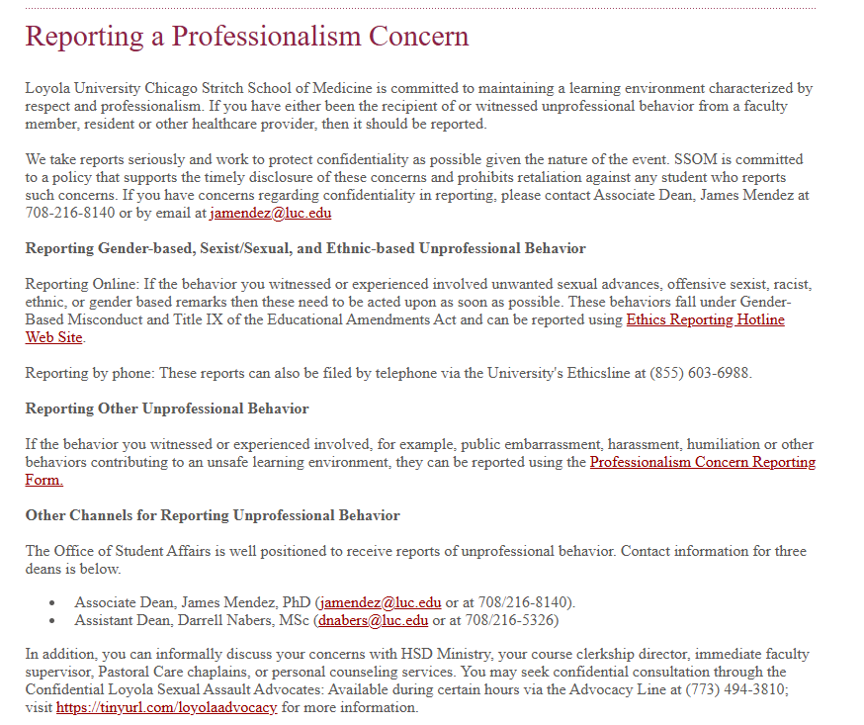

Slide 45
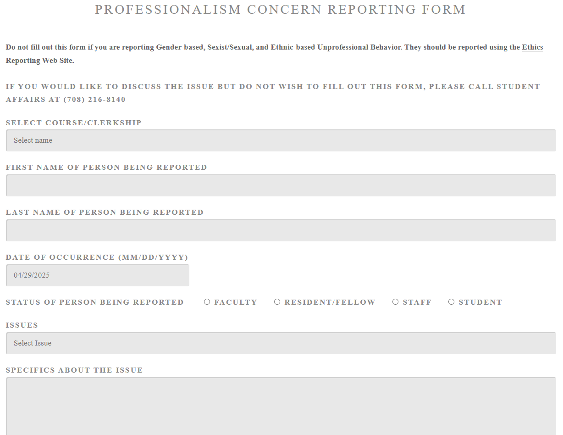

Slide 46
Page your residents or stop by the ICU after orientation and find out where/what time you need to be there on the first day

Slide 47
Questions? Comments?
emgilbert@lumc.edu

