Slide 1
Hypertension and Dyslipidemia
Joshua Evans, MD, MPH, facp
Associate Professor Internal Medicine
Medical Director – Loc General medicine

Slide 2
Objectives : Hypertension
Classify blood pressure measurement according to current definitions (e.g., Stage 1 or 2 hypertension).
  Compare home and in clinic blood pressure readings
Assess for social risk factors including tobacco, drug, and alcohol use
Assess past medical history for exacerbating factors or diseases associated with secondary hypertension including sleep apnea or renal disease
Identify characteristics and relevant review of systems that suggest uncontrolled hypertension including headaches and visual changes
Identify key physical exam findings that may suggest end organ effects of hypertension including extra heart sounds and reduced peripheral pauses
Describe a rational and evidence-based approach to treating a patient with hypertension
Describe possible complications of untreated hypertension including cerebrovascular and cardiovascular disease.

Slide 3
Objectives :Dyslipidemia
Identify relevant past medical history to determine associated risks of vascular disease including diabetes and causative medications
Assess for social risk factors including tobacco use, diet, and exercise
Assess for familial risk factors, particularly inherited causes of dyslipidemias (including familial combined hyperlipidemia)
Identify key physical exam findings that determine associated systemic effects including xanthomas, decreased peripheral pulses, and arterial bruits
Identify and interpret key laboratory and imaging tests and list indications, benefits, test characteristics, risks, and costs of testing that determine the extent of hyperlipidemia (including fasting lipid panel) and determine the secondary causes of lipid abnormalities (including fasting glucose and TSH level)
Describe a rational and evidence-based approach to treating a patient with dyslipidemia:
  Use risk calculators to decide on medical treatment including 10-year and lifetime ASCVD/mortality calculators
  Counsel patients on lifestyle modification including diet, exercise, and weight loss
  Describe treatment goals including LDL levels
  Describe frequency and type of lab monitoring including yearly LDL testing and liver enzyme monitoring
Describe a rational and evidence-based approach to screening and use patient characteristics to determine when to begin screening and frequency of screening

Slide 4
Stroke: Quick Facts
In 2018, 1 in every 6 deaths from cardiovascular disease was due to stroke
Every 40 seconds, someone in the United States has a stroke
Every 4 minutes, someone dies of stroke
Each year, more than 795,000 people in the United States has a stroke
Stroke is a leading cause of long-term disability
80% of strokes are preventable

Slide 5
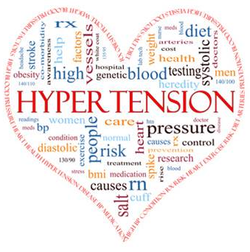
Definition and Diagnosis of HTN
> 130 mmHg systolic
  AND/OR
> 80 mmHg diastolic
  plus
Captured on 2 separate occasions
  or
Current use of antihypertensive medications

Slide 6
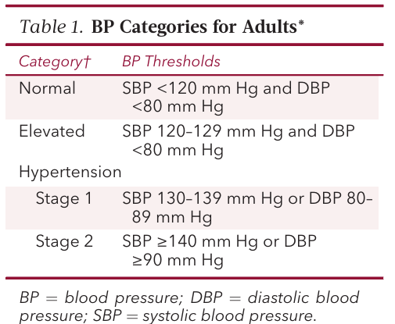

Slide 7
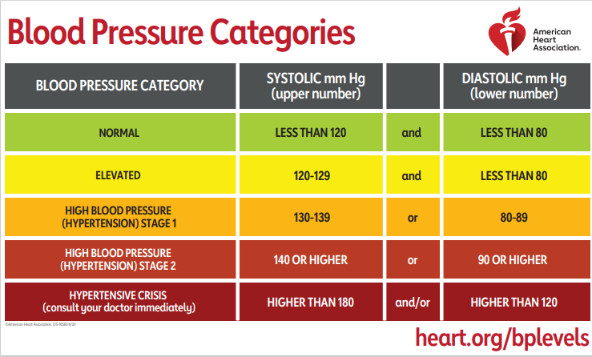

Slide 8
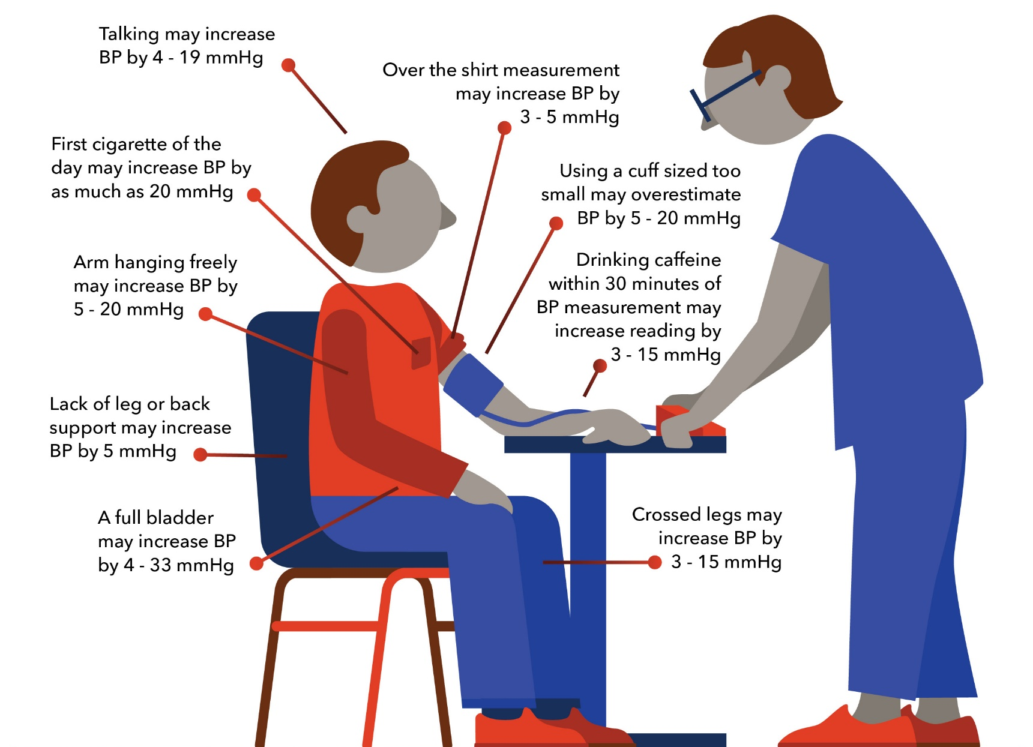
Source: American College of Cardiology

Slide 9
Hypertension
Covered in other lectures
Essential HTN = idiopathic
90 – 95%
“Multifactorial”
  Age
  Stress
  Weight
  Blood glucose
  Smoking
  Caffeine
  Cardiopulmonary fitness
  Family/Hereditary
Secondary HTN (~5%)
Renal
  Chronic Renal Failure (CRF)
  Renin secreting tumors
  Renal artery stenosis
Endocrine
  Adrenal
    Adrenocortical hyperfunction
    Pheochromocytoma
  Thyroid
    Hypothyroid
    Hyperthyroid
Cardiovascular
  Coarctation of aorta
Neuro
  ⁭ ICP

Slide 10
Diagnosis / Work-up of Hypertension – Next?
Basic Tests
  Serum potassium, creatinine, or the corresponding estimated GFR
  CBC
  Lipid profile, after 8- to 12-hour fast
  Fasting blood glucose / Hgb A1c
  TSH
  Urinalysis
Optional Tests to Consider
  EKG
  Micro-albumin/Cr. ratio

Slide 11
Complications of Hypertension
  Direct relationship between BP and cardiovascular disease
    Continuous
    Consistent
    Independent of other risk factors
  No evidence of a BP threshold for no CVD risk
    CV mortality increases progressively throughout range of BP
    Risk of CVD beginning at 115/75 mmHg and doubles with each increment of 20/10 mmHg up to 185/115 mmHg

Slide 12
Sequelae of Hypertension
Untreated:
  50% die of Ischemic Heart Disease (IHD)or Heart Failure
  33% more die of stroke (CVA-cerebrovascular accident)
Cardiac hypertrophy
Heart failure
Multi-infarct dementia / Small vessel ischemia
Aortic dissection
Arrhythmias
End stage renal failure
Retinopathy
Cardiovascular Disease

Slide 13
Hypertension: Clinical Manifestations
List of the classic symptoms of HTN …
NONE
HTN = “silent killer”
30% are unaware they have HTN
Often no symptoms until end organ damage
  Headaches, blurry vision (papilledema)

Slide 14
Hypertension: Exam findings
S3
  S3 gallop is an important and common early finding of HF associated with dilated cardiomyopathy and may also be heard in patients with diastolic HF (although less frequently than with systolic HF), aortic valve disease, and coronary artery disease (CAD)
  MR
S4
  S4 is most frequently observed in patients with decreased LV distensibility. Thus, S4 is common in hypertensive heart disease, aortic stenosis, and HCM. LV hypertrophy, which is present in all these conditions
An aortic ejection sound is also heard in some patients with systemic hypertension, probably due to associated aortic root dilation
Papilledema on fundoscopic exam

Slide 15
Severe Hypertension
Severe elevation in BP WITHOUT acute end-organ damage
  >/= 180/120 mmHg, can present with headache (which was first?)
  Most cases are inadequate treatment or nonadherent
  Can be sent home from office/ED with F/U
    Confirm pressure is responsive (i.e. short acting meds, repeat reading)
    Or if you are aware of the chronicity of the patient’s pressures
    Or, if you have an acute cause/explanation
    Obtain appropriate data : labs, EKG, imaging

Slide 16
Hypertensive Emergency
Severe elevation in BP WITH acute end-organ damage
  Hypertensive Encephalopathy
  Intracerebral / subarachnoid hemorrhage
  Acute MI / ACS
  Acute LV failure
  Acute aortic dissection
  Renal crisis (Collagen vascular disease)
  Acute glomerulonephritis
  Microangiopathic hemolytic anemia
Requires hospitalization to lower BP
  IV medication : typically beta-blocker, calcium channel blocker
  given in ICU / Step-down unit
  Target: reduce by 10% in 1 hour, 5-15% in next 23 hours
Exceptions
Acute Ischemic Stroke - not lowered unless it is ≥185/110 mmHg in patients who are candidates for reperfusion therapy or ≥220/120
Acute Aortic Dissection – SBP should be rapidly lowered to a target of 100 to 120 mmHg (goal is within 20 minutes)

Slide 17
Benefits of Lowering Blood Pressure
For each 10 mmHg decrease in systolic BP…
. . . 30% decrease risk of heart mortality
. . . 40% decrease risk of stroke mortality
Antihypertensive therapy reduces…..
  CVA 35-40%
  MI 20-25%
  CHF >50%
Stage 1 HTN (130-139/80-89 mmHg)
  Reduce systolic BP 12 mmHg over 10 yrs, prevents 1 death for every 11 treated

Slide 18
Hypertension Treatment
  Lifestyle modifications
  Medications
  Treat underlying condition / secondary cause

Slide 19
Hypertension : Lifestyle modifications
Diet
  Healthy choices
    Low salt, increased vegetables (DASH)
  Healthy Portions
    Calorie reduction
  Reduce Alcohol Consumption
Exercise
  Cardiopulmonary fitness vs “active”
  Heart rate to 120 bpm for at least 20 mins
Weight loss
  See above
  Set small goals – baby steps
Smoking Cessation

Slide 20
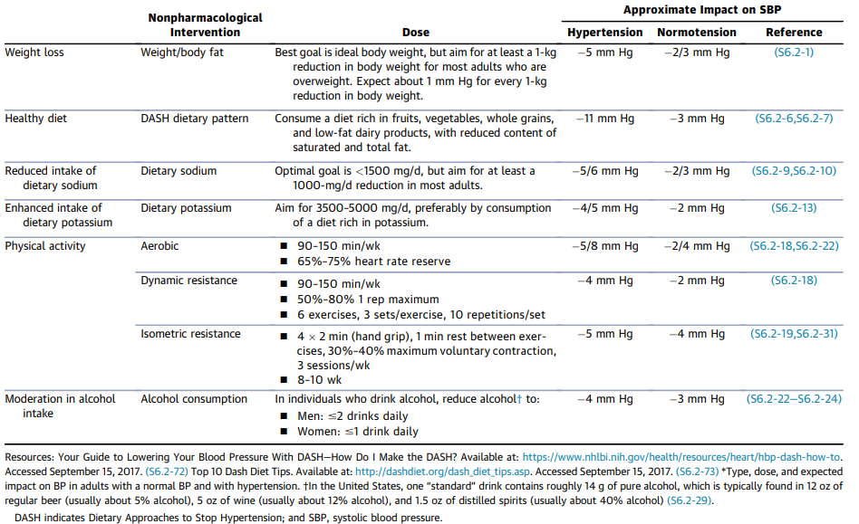

Slide 21
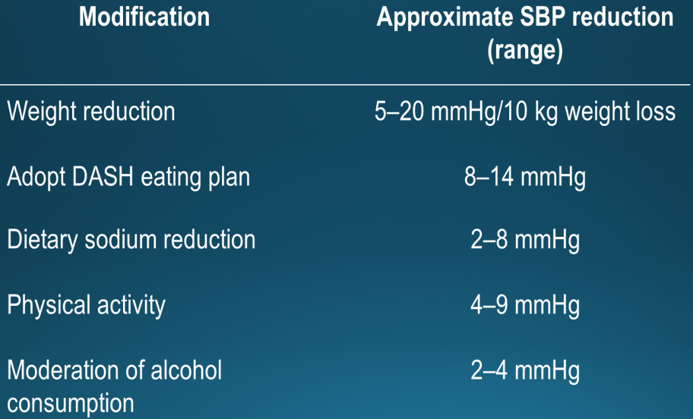

Slide 22
Antihypertensive Agents
Thiazide Diuretic
  Hydrochlorithiazide
  Chlorthalidone
ACE Inhibitors
  Lisinopril, Enalapril, Captopril, benazepril
ARB
  Losartan, valsartan, candesartan
Heart Disease
Avoid in Gout, BPH
Beta Blockers
  Metoprolol, atenolol, carvedilol, labetalol, esmolol
Calcium Channel Blockers
  Diltiazem, verapamil , amlodipine, nifedipine,
Diabetes
Advanced CKD
Diabetes

Slide 23
Hypertension Management
Initiate Therapy
Follow up in 4 weeks or less until below 140/90
  With Labs if appropriate (Cr. , K)
Follow up frequency determined by target and co-morbid conditions
Minimum: Twice a year / Every 6 months

Slide 24
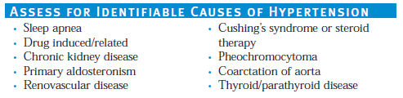
Resistant Hypertension
Failure to reach goal BP in pts who are adhering to full doses or an appropriate three-drug regimen that includes a diuretic.
JNC 7, ACC/AHA 2017
  ….or when control is achieved but requires 4 or more medications.
Should prompt a survey / consideration for secondary causes

Slide 25
Dyslipidemia: Definition
Lipid disorders – Includes disorders of lipoprotein metabolism but also lipodystrophies and some lipid storage disorders
Hyperlipidemia – Elevation of serum total or LDL cholesterol or triglyceride
Hypercholesterolemia - Elevation of LDL or Total cholesterol, normal triglycerides
Hypertriglyceridemia – Elevation of triglycerides
Dyslipidemia - a large range of lipid abnormalities and may involve a combination of
  Increased total cholesterol (≥240 mg/dL [6.20 mmol/L])
  LDL-C (>160 mg/dL [4.13 mmol/L]),
  Triglyceride levels (>200 mg/dL [2.25 mmol/L])
  Decreased HDL-C (<40 mg/dL [1.03 mmol/L])
  Optimal levels
    Total Cholesterol : <150 mg/dL
      Correlates to an LDL ~ 100 mg/dL
    HDL: >39 mg/dL
    Triglycerides: <150

Slide 26
Dyslipidemia: Scope
By World Health Organization (WHO) definitions, about 40 percent of people globally have elevated total cholesterol levels, while about 50 percent have elevated levels in Europe and the Americas
About 1 in 5 adolescents have an unhealthy cholesterol reading, and nearly 93 million U.S. adults age 20 or older have high cholesterol
But since high cholesterol doesn’t have symptoms, many people don’t know their levels are high

Slide 27
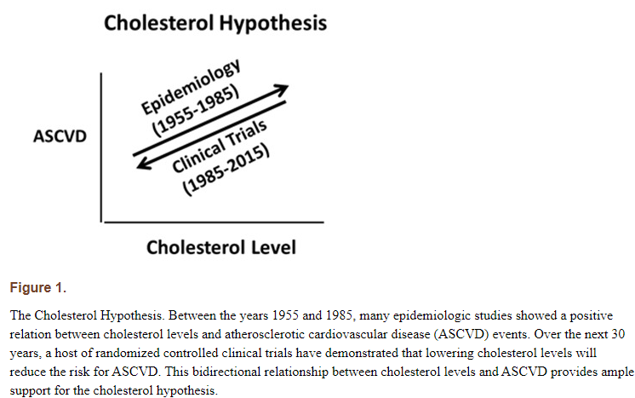

Slide 28
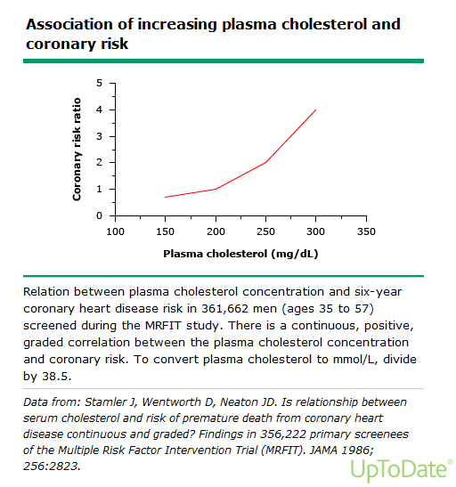

Slide 29
Dyslipidemia : Screening
Cholesterol should be checked starting early in life—even children and adolescents should have their cholesterol checked.
Cholesterol testing should be done very 5 years for people aged 20 or older who are at low risk for cardiovascular disease
The ACC/AHA recommends that all adults aged 20–78 years have a fasting lipid profile measured every 4–6 years if there is no atherosclerotic CVD and more often if this condition is present
Lipid testing is relatively quick, easy, and inexpensive
The tests are generally reliable
  should include baseline measurement of total cholesterol, LDL-C, HDL-C, and triglyceride levels
  For patients with a history of CVD or those with a very high level of risk, tests that may be considered in addition to the baseline lipid profile include measurement of lipoprotein(a), apolipoprotein B, and apolipoprotein A1

Slide 30
Dyslipidemia: Measurement
Fasting
First time a lipid profile is obtained
For the purpose of following known hypertriglyceridemia
  Strongly affected by food consumption
Ask the patient to fast for 8-10 hours
  (before breakfast)
Non-fasting
Ok in any other case
Serum total and HDL-C are measured directly and can be obtained in fasting or nonfasting individuals; there are only small, clinically insignificant differences in these values between measurements in the fasting or non-fasting state

Slide 31
Dyslipidemia: Risk factors
A family history of heart disease or high blood cholesterol: You are more at risk of having high cholesterol if other people in your family have it
Diabetes: Type 2 diabetes raises “bad” cholesterol and lowers high-density lipoprotein (HDL), or “good,” cholesterol, raising the risk for heart disease and stroke.
Older age: As you age, your body can’t clear cholesterol as well as it used to.
Being male. Men tend to have higher LDL and lower HDL cholesterol levels than women do. But after menopause (around age 55), LDL cholesterol levels in women increase.^{4,5}
Overweight or obesity. Excess weight, unhealthy eating habits, and lack of physical activity can lead to high cholesterol

Slide 32
Dyslipidemia : Etiology
Primary
  Inheritable condition
  Overproduction or defective clearance of triglycerides and cholesterol
  Monogenic and polygenic – see table
    Familial Combined Hypercholesterolemia
Secondary
  Accounts for 30-40%
  Unhealthy lifestyle factors
  Acquired medical conditions
Diabetes Mellitus
Cholestatic Liver disease
Hypothyroidism
Nephrotic Syndrome
Obesity
Excessive Alcohol intake
Cigarette Smoking
Medications

Slide 33
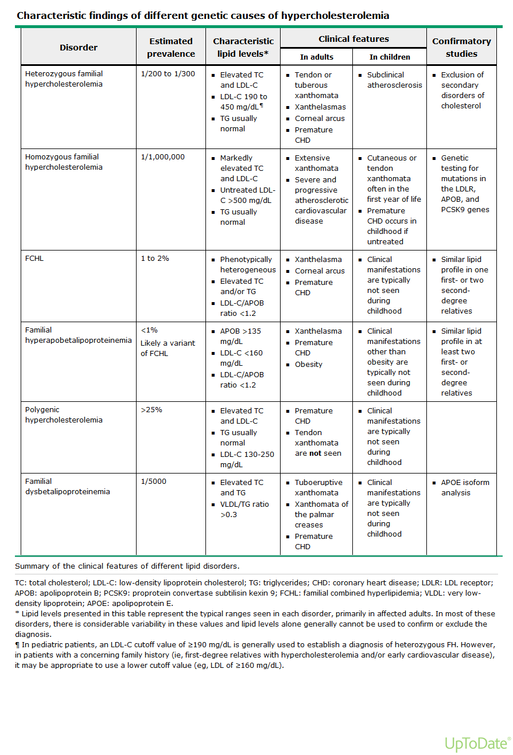

Slide 34
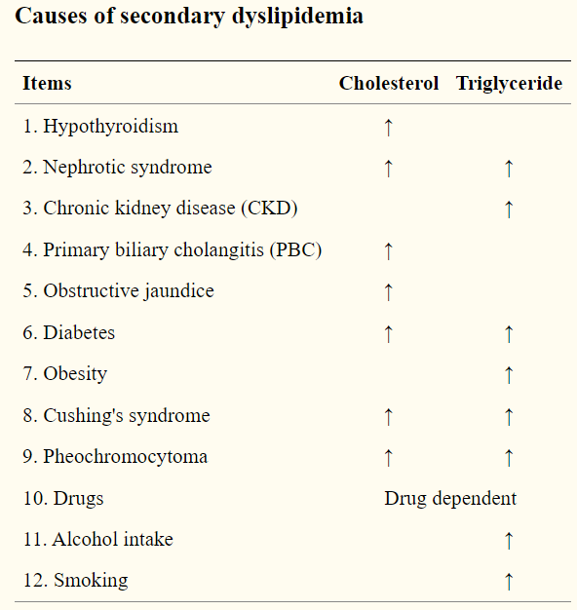
Secondary Dyslipidemia

Slide 35
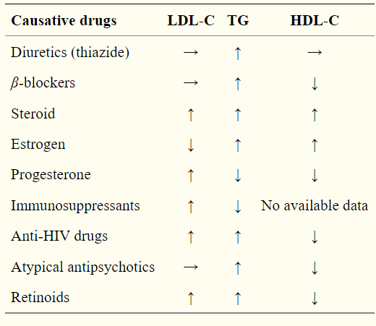
Dyslipidemia: Meditation Culprits
  Atypical antipsychotic agents:
    clozapine and olanzapine- associated with weight gain, obesity, hypertriglyceridemia, and development of diabetes mellitus
  Antiretroviral regimens HIV infection:
    protease inhibitors- lipodystrophy syndrome
  Thiazides, beta blockers, estrogen

Slide 36
Dyslipidemia : Secondary
  Smoking: lowers HDL and impairs HDL function
  Alcohol: excessive intake (>1 drink /day for female, >2 drinks/day for male) raises triglycerides
  CKD: elevations in low-density lipoprotein (LDL) cholesterol and triglycerides, and low levels of high-density lipoprotein (HDL) cholesterol; hypertriglyceridemia (type IV hyperlipoproteinemia) occurs in 30 to 50 percent of cases of CKD
  Nephrotic syndrome: Increased hepatic production of lipoproteins (induced in part by the fall in plasma oncotic pressure) is the major abnormality, but also diminished lipid catabolism
  Primary biliary cholangitis and similar disorders may be accompanied by marked hypercholesterolemia that results from an accumulation of lipoprotein-X

Slide 37
Dyslipidemia : DMII
  Hyperlipidemia in association with insulin resistance is common in patients with type 2 diabetes mellitus
  Insulin resistance is associated with larger very low-density lipoprotein (VLDL) particle size, smaller LDL particle size, and smaller HDL particle size
  The number of VLDL, intermediate-density lipoprotein (IDL), and LDL particles increase with increasing insulin resistance, while HDL particle concentration decreases
  Hypertriglyceridemia results both from increased substrate availability (glucose and free fatty acids) and from decreased lipolysis of VLDL triglyceride
Type II Diabetes Mellitus : essentially a stand-alone reason to treat with statin therapy

Slide 38
Dyslipidemia : Hypothyroid
  1- 5% of hypercholesterolemia have overt to sub-clinical hypothyroid
    Thus, all patients with hypercholesterolemia (and hypertriglyceridemia) should be screened for hypothyroidism
  The primary mechanism for hypercholesterolemia in hypothyroidism is accumulation of LDL cholesterol due to a reduction in the number of cell-surface receptors for LDL, resulting in decreased catabolism of LDL. A decrease in LDL receptor activity has also been described
  Treatment with T4 (levothyroxine) improves total and LDL cholesterol
    Treating only with statin can induce myopathy

Slide 39
Dyslipidemia : Clinical Manifestations
  Generally – none from just elevated levels
  Genetic Disease – some visible manifestations of excessive cholesterol
    Xanthomas are lesions on the skin containing cholesterol and fats
      may manifest as papules, plaques, or nodules in skin
    Corneal Arcus or Arcus Senelis in geriatric patients
      Always abnormal in <40
      Cholesterol deposition around the cornea, visible when looking at the rim of the iris
Often, the manifestation is vascular disease: Claudication, diminished pulses, bruits

Slide 40
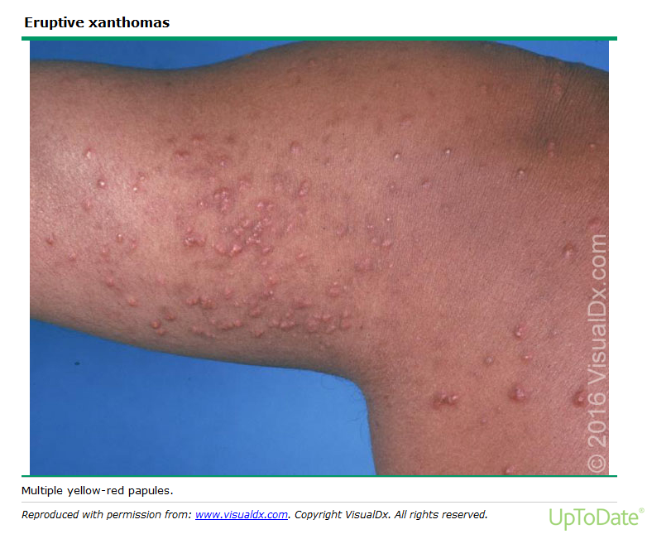
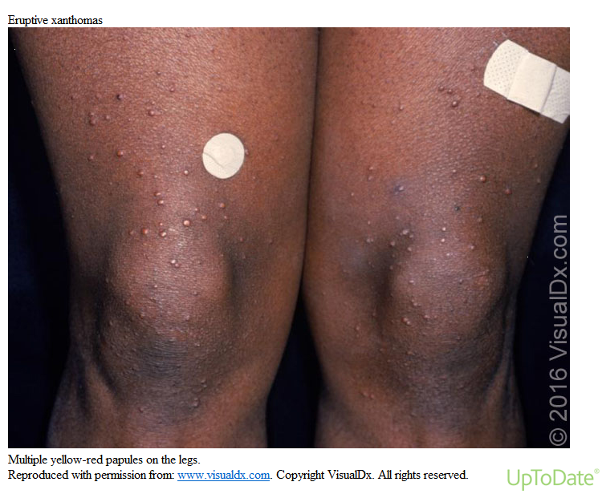
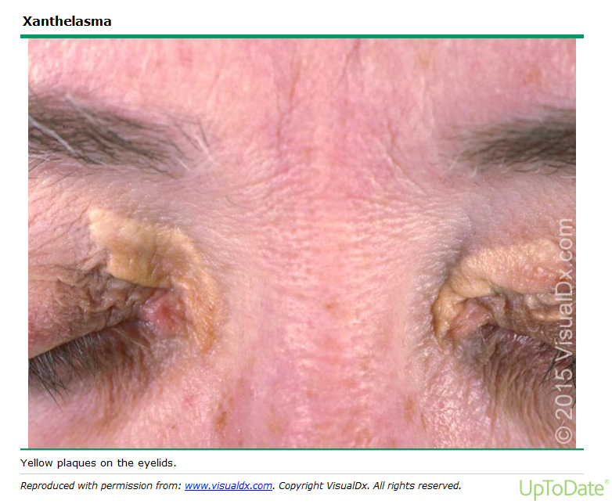
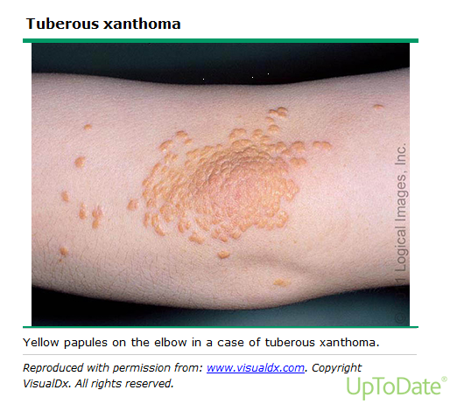

Slide 41
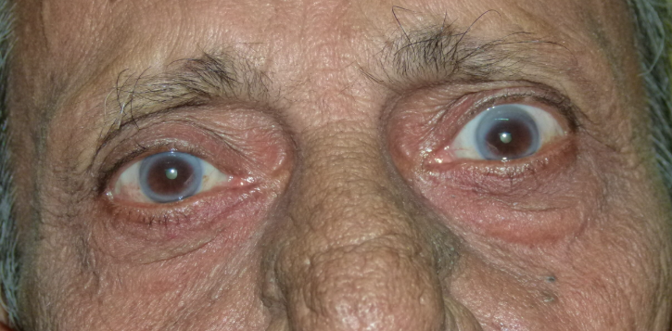

Slide 42
Familial Combined hyperlipidemia
  FCHL is a common genetic lipid disorder (1 to 2 percent of the population)
  FCHL is a complex, polygenic disorder in which gene variants causing elevations of VLDL and of LDL in the same families
  Patients present with elevated levels of plasma total cholesterol, low density lipoprotein cholesterol (LDL-C), triglycerides, and apolipoprotein (apo) B
  FCHL is caused by overproduction of hepatically-derived apoB-100 associated with very low-density lipoprotein (VLDL)
    an autosomal dominant pattern of inheritance
    LDL phenotype A is associated with large buoyant LDL particles
    LDL phenotype B is characterized by small, dense LDL particles, low HDL, and High triglycerides

Slide 43
Familial Combined Hyperlipidemia
  Screening relatives reveals variable dyslipidemia:
    some with an increase in both cholesterol and triglycerides
    some with increased cholesterol but normal triglyceridemia
    some with principally hypertriglyceridemia (often mild, but occasionally type V)
    and others there is little dyslipidemia.
  Premature atherosclerotic cardiovascular disease (ASCVD) is not uncommon
  There is an increased future likelihood of impaired glucose tolerance or type 2 diabetes

Slide 44
Familial Combined Hyperlipidemia
Diagnosis :
  FCHL is diagnosed in patients with a family history of premature CHD and whose apoB concentration is >120 mg/dL in combination with either elevations in both LDL-C and triglycerides or either elevated LDL-Col or triglycerides
  The diagnosis of this disorder or the possible variant hyperapobetalipoproteinemia requires family data
  No family data – it is suggested by an LDL-to-apoB ratio of less than 1.2 (normal value >1.4).

Slide 45
Familial Combined Hyperlipidemia
Treatment:
  The first-line treatment is a statin - which is effective therapy for lowering apoB levels
    irrespective of whether or not triglyceride levels are elevated
  Goal - of achieving LDL-C <100 mg/dL in primary prevention and <70 mg/dL in secondary prevention
  Statins are used before fibrates in hyper triglyceridemic dyslipidemias
    They are not better at lowering triglycerides, but randomized clinical trial evidence show that they are safe and that they decrease cardiovascular disease risk and mortality
    High intensity statins (atorvastatin 80 mg and rosuvastatin 40 mg) lower triglycerides by 43 percent in patients with triglycerides as high as 800 to 850 mg/dL

Slide 46
Dyslipidemia: Treatment
  Treatment of lipid disorders in patients at high risk of (or with established) CHD
  Large RCTs: LDL-C lowering has been consistently shown to reduce the risk of ASCVD
    a lowering of LDL-C levels of 1% gives an approximate ~1% reduction in the risk of ASCVD
  Statin therapy is divided into 3 categories
    High-intensity statin therapy typically lowers LDL-C levels by ≥50%
    Moderate-intensity statin therapy by 30% to 49%
    Low-intensity statin therapy by <30%
  Other LDL-lowering drugs:
    ezetimibe, bile acid sequestrants, and PCSK9 inhibitors
Triglyceride-lowering drugs : fibrates and niacin
  They have a mild LDL-lowering action
  RCTs do not support their use as add-on drugs to statin therapy

Slide 47
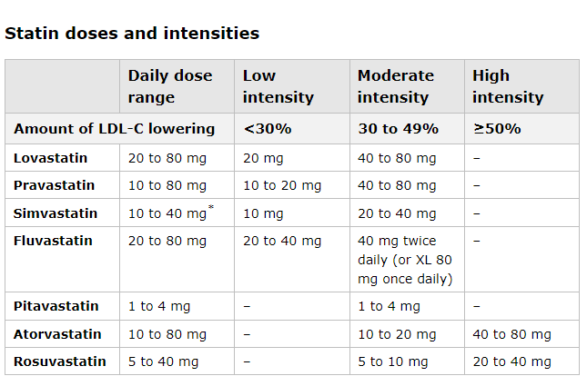


Slide 48
Dyslipidemia: Treatment is Risk based
  Patients ages 20-75 years and LDL-C ≥190 mg/dl, use high-intensity statin without risk assessment
  T2DM and age 40-75 years, use moderate-intensity statin and risk estimate to consider high-intensity statins
  Age 40-75 years and LDL-C ≥70 mg/dl and <190 mg/dl without diabetes, use the risk calculator
    Risk 7.5% to <10% Risk discussion: if risk-enhancing factors are present, discuss moderate-intensity statin
    Risk ≥10-20% - use moderate-intensity statins and increase to high-intensity with risk enhancers
    Risk ≥20% - initiate high-intensity statin to reduce LDL-C by ≥50%
  Age >75 years, clinical assessment and risk discussion

Slide 49
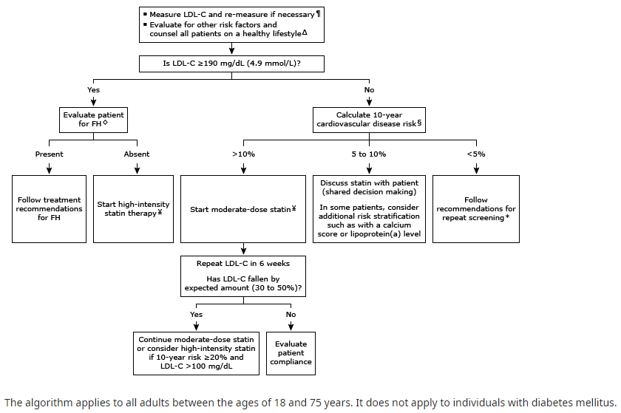
Elevated LDL in Adults
WITHOUT
Cardiovascular Disease

Slide 50
Updated Guidelines
2026 ACC/AHA/Multisociety Dyslipidemia Guideline
LDL-C goals are back
  with risk-based targets for primary and secondary prevention
Plus: PREVENT • Lp(a) • ApoB • CAC

Slide 51
Primary Prevention: Ages 30–79, LDL-C 70–189 mg/dL
10-year PREVENT risk | Category | Treatment approach | Goal
<3% | Low | Lifestyle; selected younger adults may merit therapy based on LDL-C/30-year risk | No universal LDL-C target
3%–<5% | Borderline | Moderate-intensity statin is reasonable after discussion | LDL-C <100; non–HDL-C <130
5%–<10% | Intermediate | At least moderate-intensity statin; high-intensity may benefit higher end | LDL-C <100; non–HDL-C <130
≥10% | High | High-intensity statin | LDL-C <70; non–HDL-C <100
2026 ACC/AHA Multisociety Dyslipidemia Guideline

Slide 52
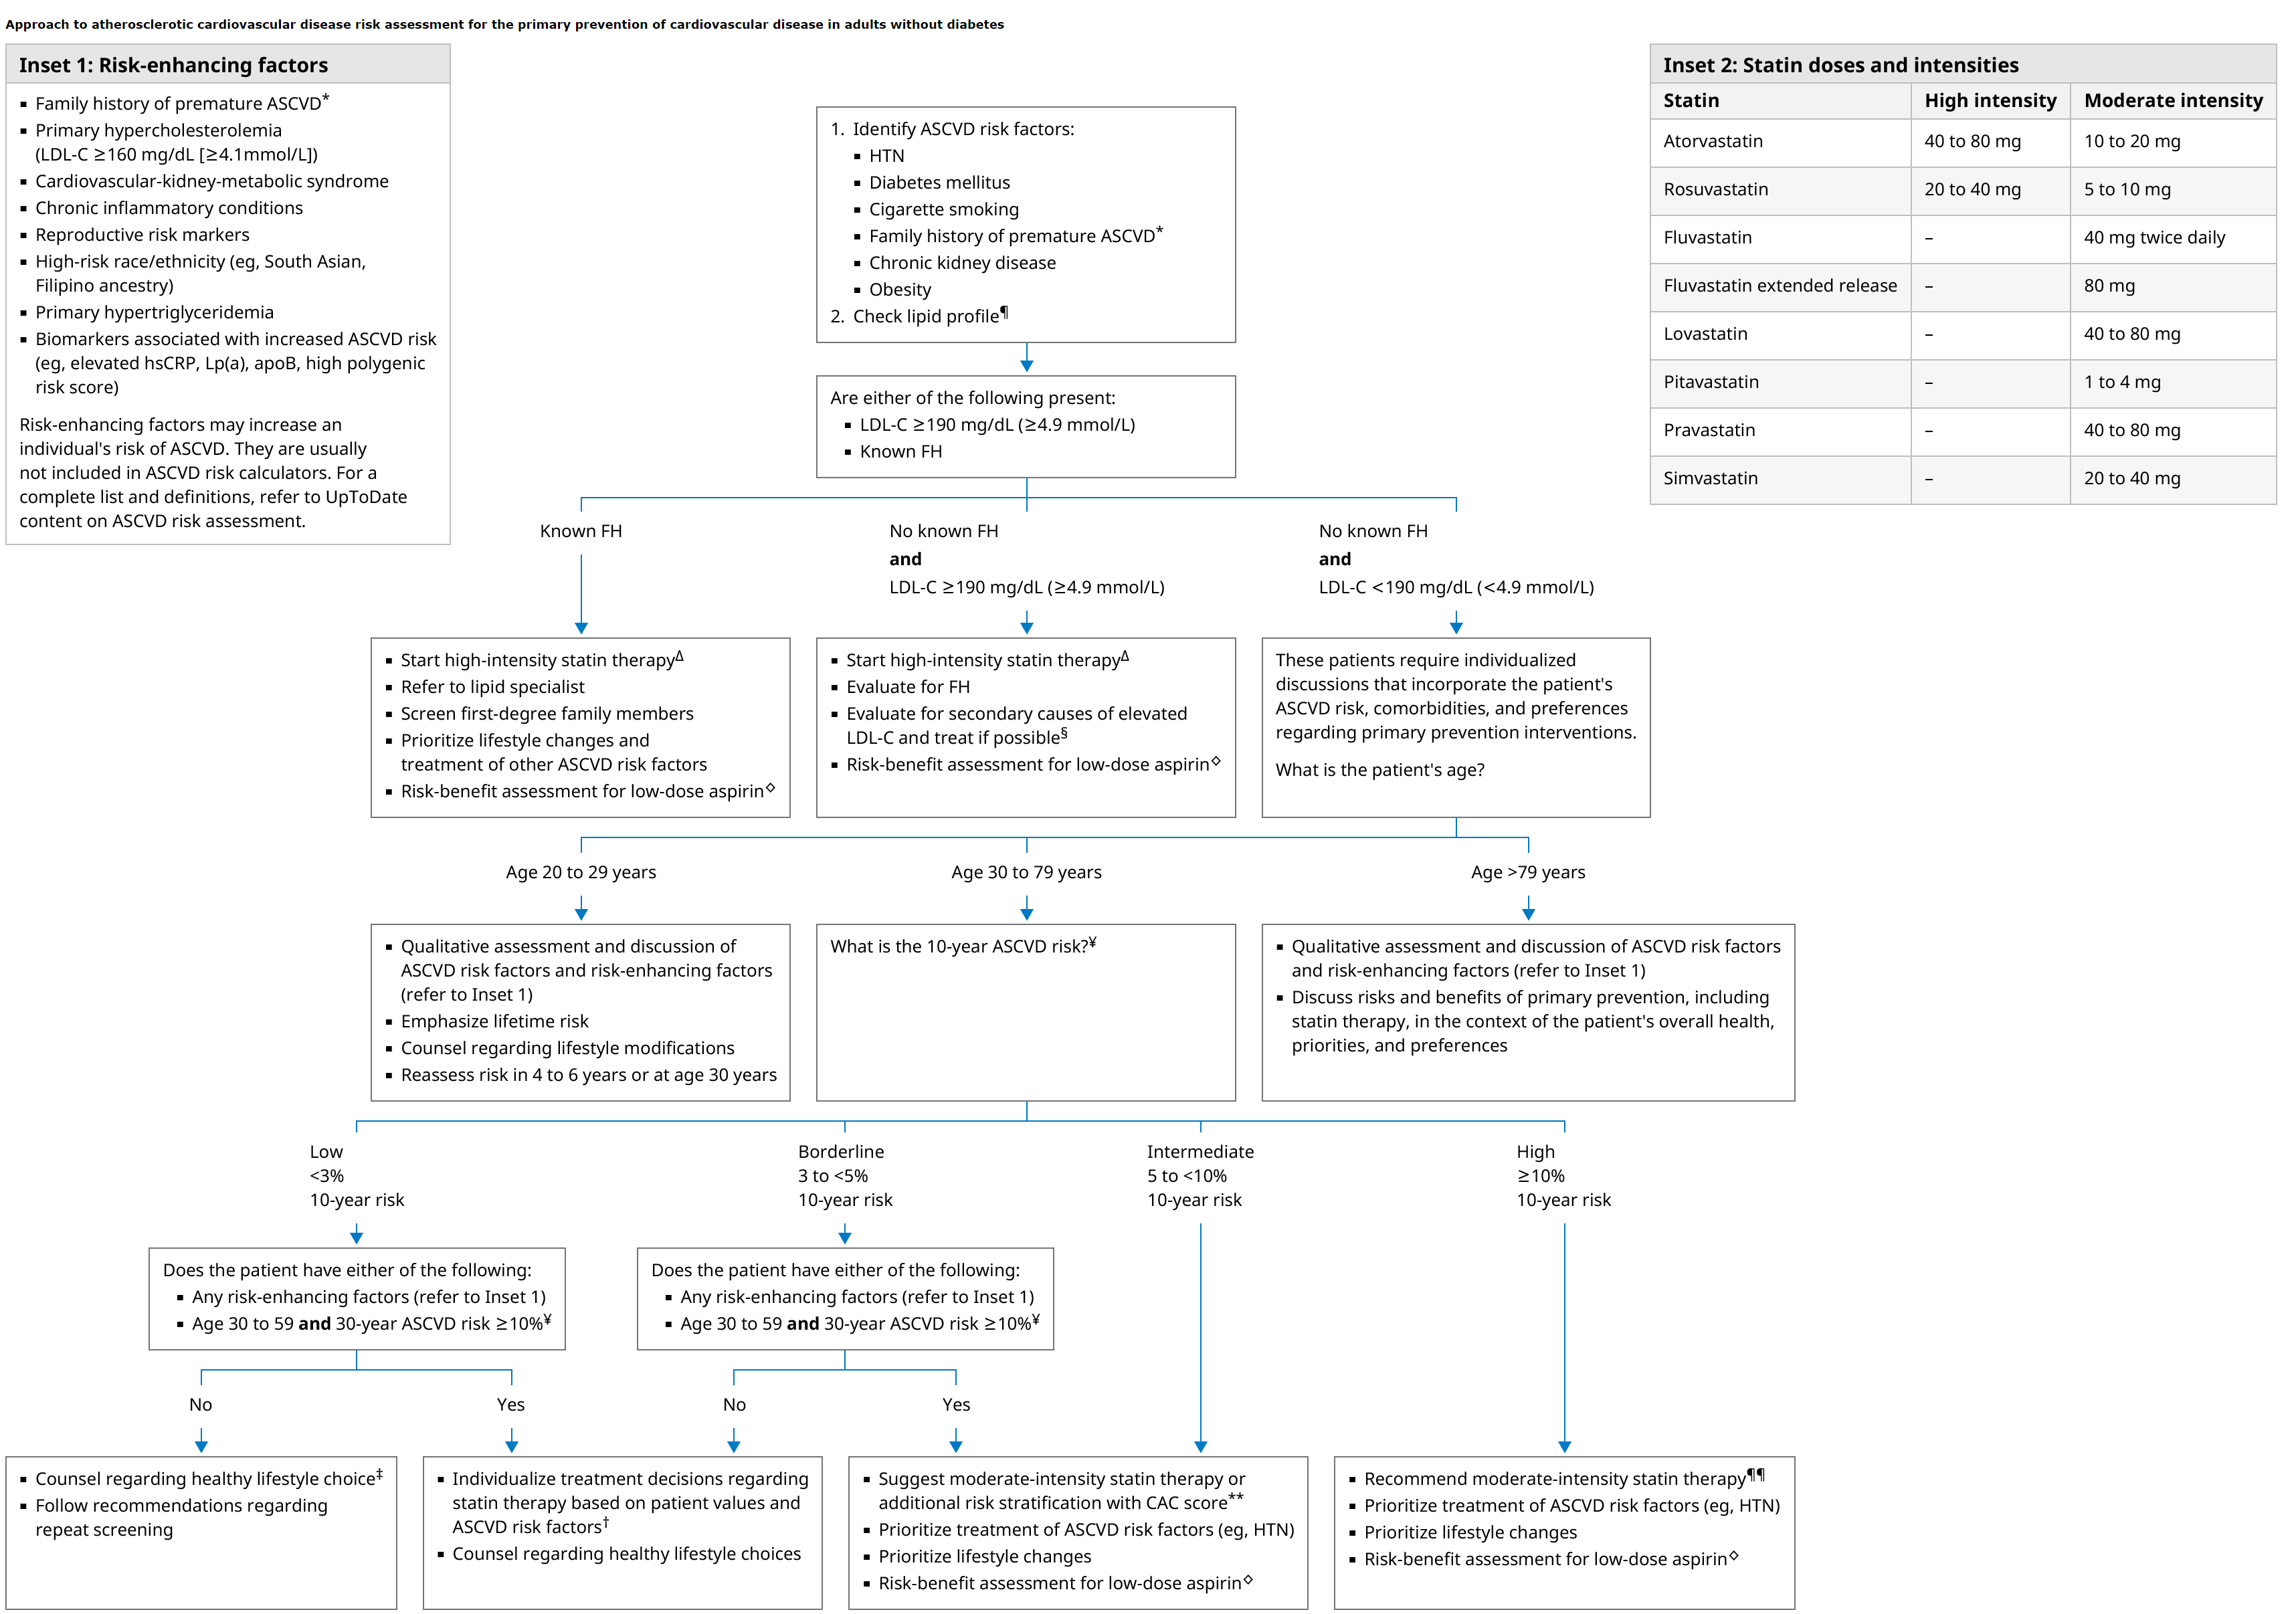

Slide 54
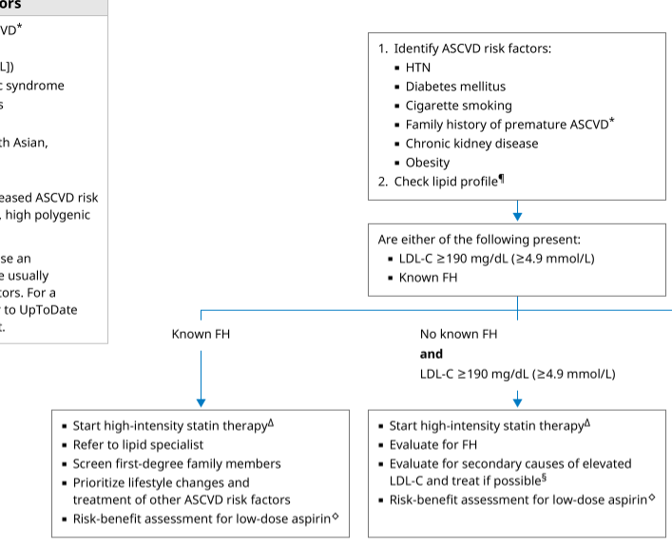

Slide 56
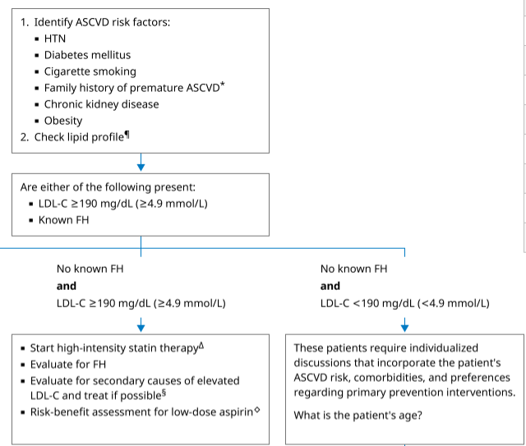

Slide 58
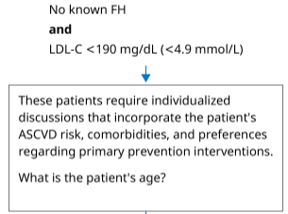
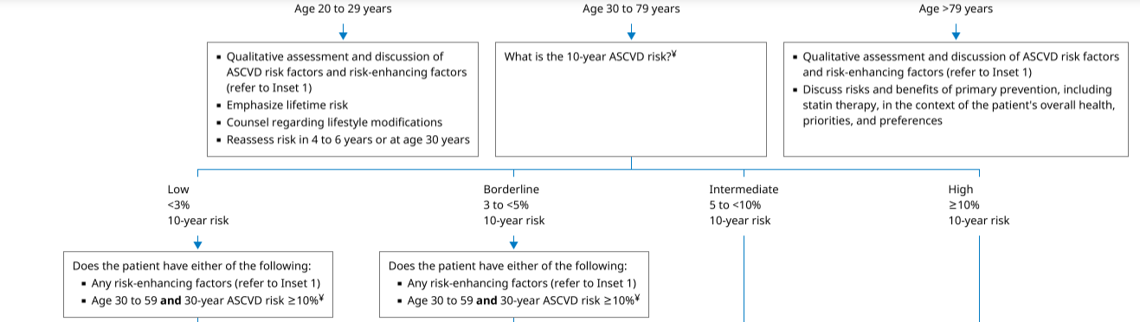

Slide 59
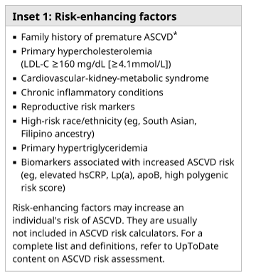
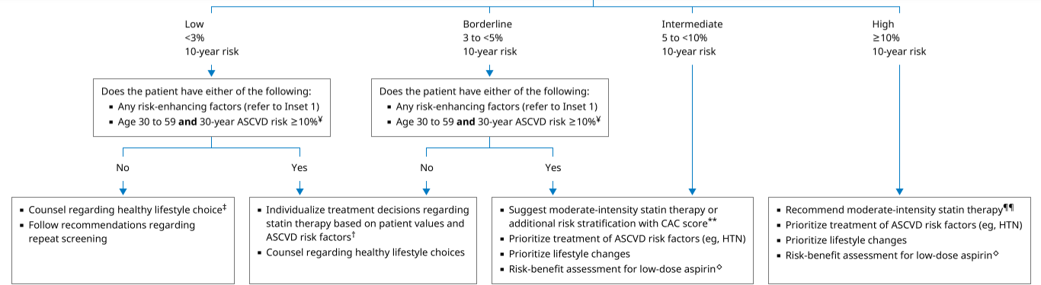

Slide 64

ASCVD Risk Estimate
https://tools.acc.org/ascvd-risk-estimator-plus/#!/calculate/estimate/

Slide 65
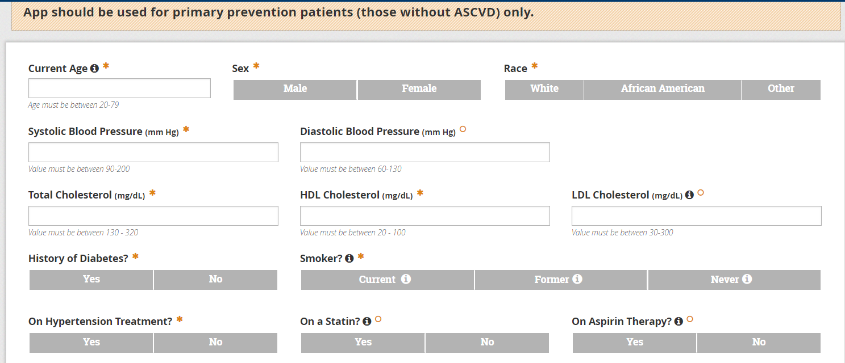

Slide 66
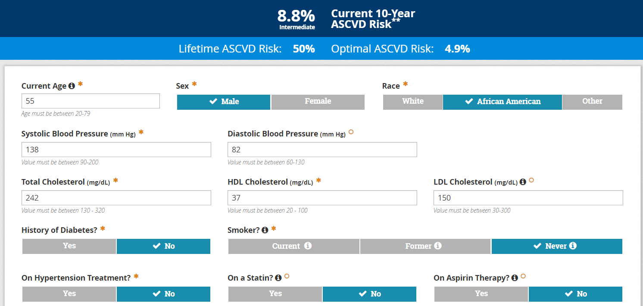

Slide 67
PREVENT - ASCVD Risk Estimate
https://tools.acc.org/ascvd-risk-estimator-plus/#!/calculate/estimate/

Slide 68
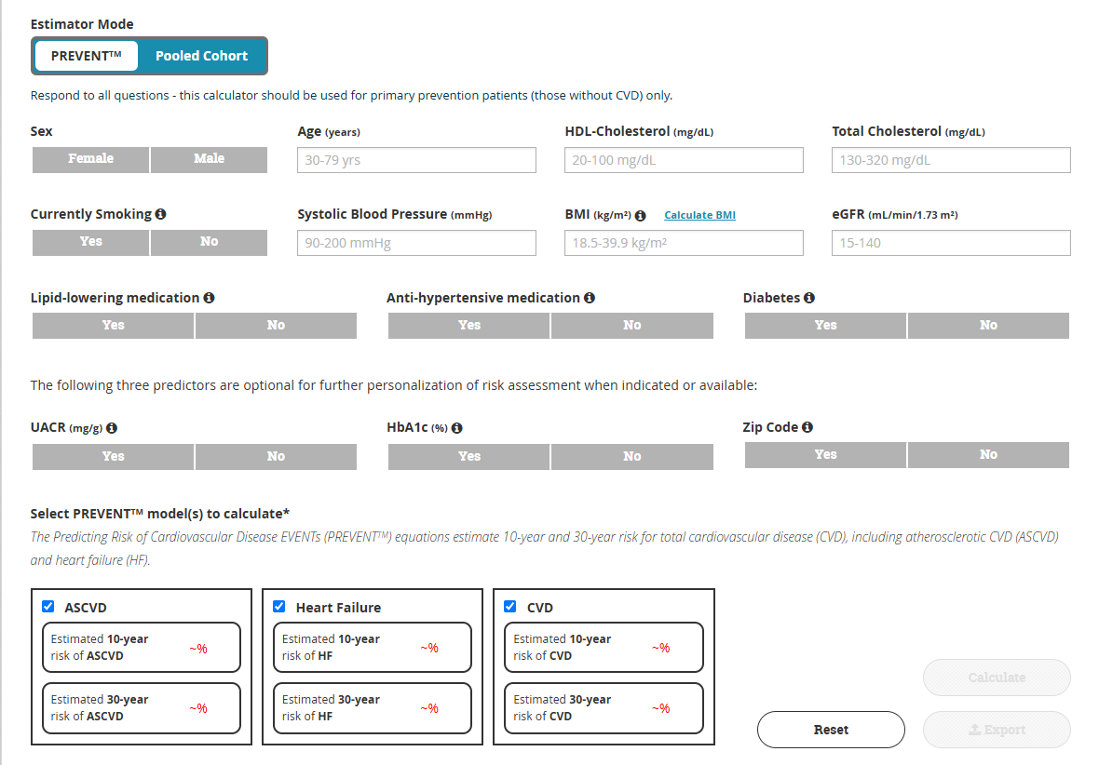

Slide 69
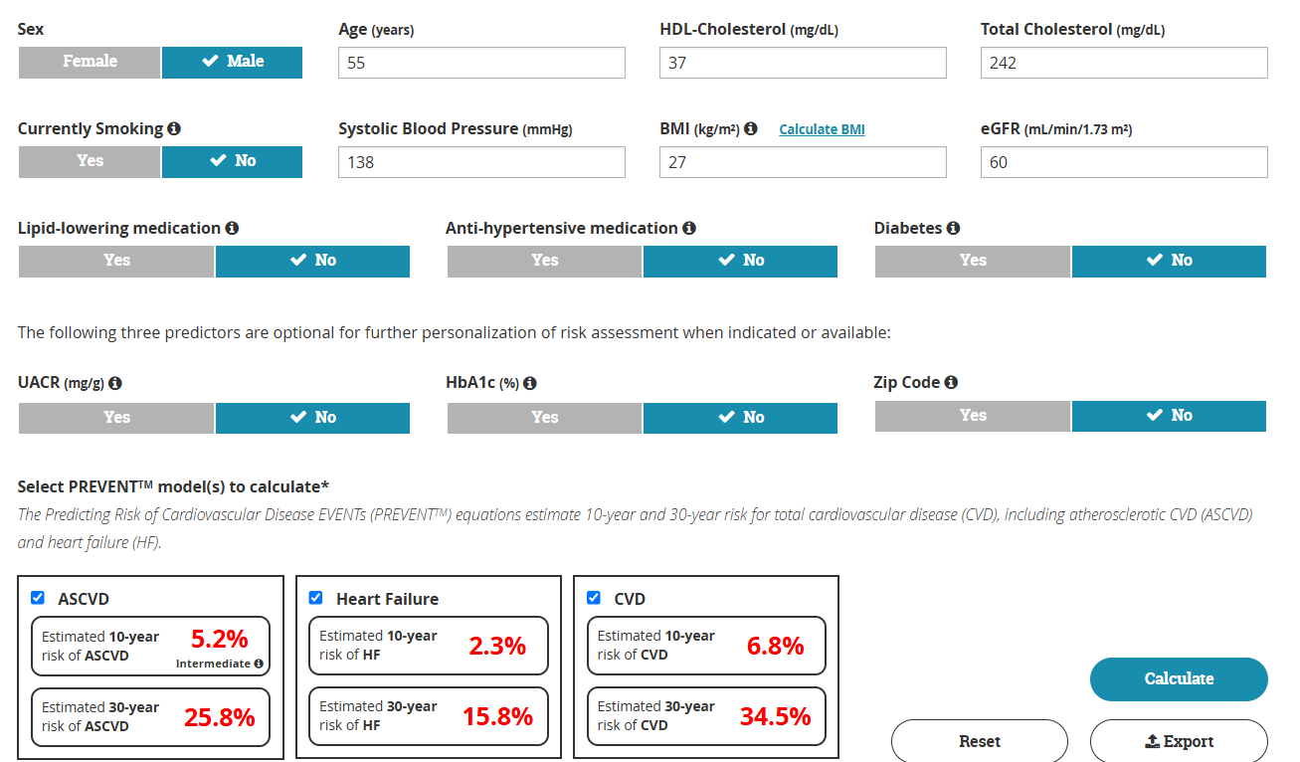

Slide 70
Secondary Prevention: Clinical ASCVD
Risk group | LDL-C goal | Non–HDL-C goal | Core treatment
Very high risk | <55 mg/dL | <85 mg/dL | High-intensity statin; add ezetimibe and/or PCSK9 mAb if needed
Not very high risk | <70 mg/dL | <100 mg/dL | High-intensity statin; add nonstatin therapy if needed
Target ≥50% LDL-C reduction in very-high-risk ASCVD.
For ASCVD not at very high risk, <70 mg/dL is the primary goal; intensification to <55 mg/dL may be reasonable in selected patients.
2026 ACC/AHA Multisociety Dyslipidemia Guideline

Slide 71
LDL-C & Non–HDL-C Targets at a Glance
Clinical situation | LDL-C goal | Non–HDL-C goal
ASCVD • very high risk | <55 mg/dL | <85 mg/dL
ASCVD • not very high risk | <70 mg/dL | <100 mg/dL
Primary prevention • high risk (≥10%) | <70 mg/dL | <100 mg/dL
Primary prevention • borderline/intermediate (3%–<10%) | <100 mg/dL | <130 mg/dL
Severe hypercholesterolemia • uncomplicated | <100 mg/dL | <130 mg/dL
LDL ≥190 + HeFH/additional risk/CAC | <70 mg/dL | <100 mg/dL
2026 ACC/AHA Multisociety Dyslipidemia Guideline

Slide 72
Dyslipidemia: Management
Statin therapy
  Baseline liver transaminases
  No need for surveillance of ALT unless signs of hepatotoxicity
An asymptomatic increase in transaminases (>3 times upper limit of normal)
  is an infrequent statin-associated side effect
  often resolves with dose reduction
  or rechallenge with alternative statins
Severe statin-associated hepatotoxicity is rare
  not impacted by routine monitoring of transaminases.
Statins are not contraindicated in patients with increased ASCVD risk with chronic, stable liver disease (eg, nonalcoholic fatty liver)

Slide 73
Dyslipidemia : Lifestyle Changes
Emphasize intake of whole grains, legumes, healthy protein sources (low-fat dairy, low-fat poultry, fish/seafood, and nuts), and non-tropical vegetable oils
Emphasize foods high in fiber, such as fresh fruits and vegetables, and in unsaturated fats, such as avocados and nuts
Limit intake of sweets, sugar-sweetened beverages, and red meats
Limit foods that are high in saturated or trans fats, sugar, and sodium (salt)
Physical Activity: same targets as for blood pressure
Smoking cessation or avoidance

Slide 74
References
National Heart, Lung, and Blood Institute. Third Report of the National Cholesterol Education Program (NCEP) Expert Panel on Detection, Evaluation, and Treatment of High Blood Cholesterol in Adults (Adult Treatment Panel III) Final Report. NIH Pub. No. 02-5215. Bethesda, MD: National Heart, Lung, and Blood Institute; 2002.
Grundy SM, Stone NJ, Bailey AL, Beam C, Birtcher KK, Blumenthal RS, et. al. 2018 AHA/ACC/AACVPR/AAPA/ABC/ACPM/ADA/AGS/APhA/ASPC/NLA/PCNA Guideline on the Management of Blood Cholesterol: a report of the American College of Cardiology/American Heart Association Task Force on Clinical Practice Guidelinesexternal icon. Circulation. 2019;139(25):e1082–e1143.
ACC/AHA/AAPA/ABC/ACPM/AGS/APhA/ASH/ASPC/NMA/PCNA Guideline for the Prevention, Detection, Evaluation, and Management of High Blood Pressure in Adults: A Report of the American College of Cardiology/American Heart Association Task Force on Clinical Practice Guidelines. J Am Coll Cardiol 2018;71:e127-e248.
Blumenthal, R, Morris, P, Gaudino, M. et al. 2026 ACC/AHA/AACVPR/ABC/ACPM/ADA/AGS/APhA/ASPC/NLA/PCNA Guideline on the Management of Dyslipidemia: A Report of the American College of Cardiology/American Heart Association Joint Committee on Clinical Practice Guidelines. JACC. 2026 May, 87 (19) 2624–2757.https://doi.org/10.1016/j.jacc.2025.11.016
2014 Evidence-Based Guideline for the Management of High Blood Pressure in Adults: Report From the Panel Members Appointed to the Eighth Joint National Committee (JNC 8), JAMA. 2014;311(5):507-520. doi:10.1001/jama.2013.284427
Secondary dyslipidemia: its treatments and association with atherosclerosis Hidekatsu Yanai ^{1 ,*} and Hiroshi Yoshida ^{2.} Glob Health Med. 2021 Feb 28; 3(1): 15–23.;Published online 2021 Feb 28. doi: 10.35772/ghm.2020.01078. PMCID: PMC7936375 PMID: 33688591
Harrison’s Principles of Internal Medicine, 18th Edition.
Robbins Basic Pathology, 9th Edition, pp. Hypertensive Vascular Disease pp. 332-334; Malignant Hypertension pp. 539-40.
The Seventh Report of the Joint National Committee on Prevention, Detection, and Treatment of High Blood Pressure.
UpToDate. Uptodateonline.com Last Accessed 15 min ago.
Centers for Disease Control. Cdc.gov Last accessed 8/2021.
World Health Organization. WHO.int Last accessed 8/2021
ACP In the Clinic

